Slide 1

Chong Ho Alex Yu

Slide 2
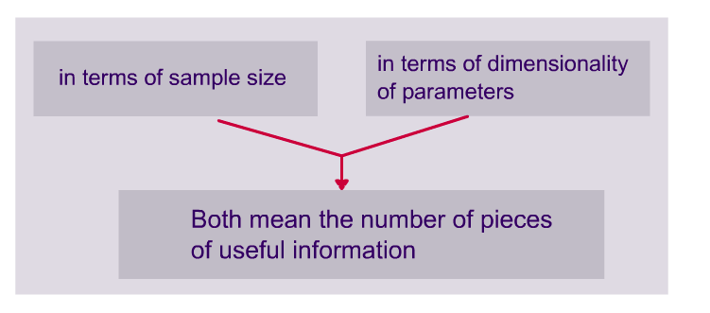
Degrees of freedom

Slide 3
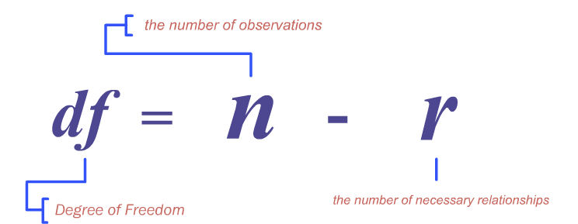


Slide 4
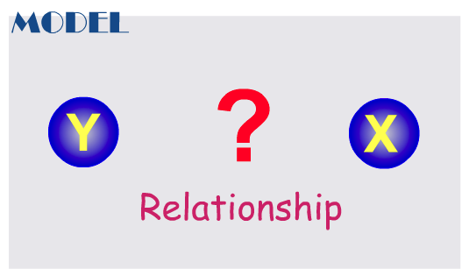


Slide 5
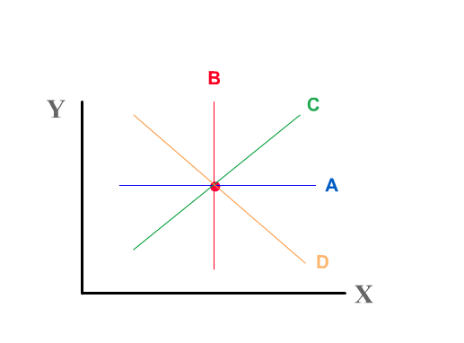


Slide 6
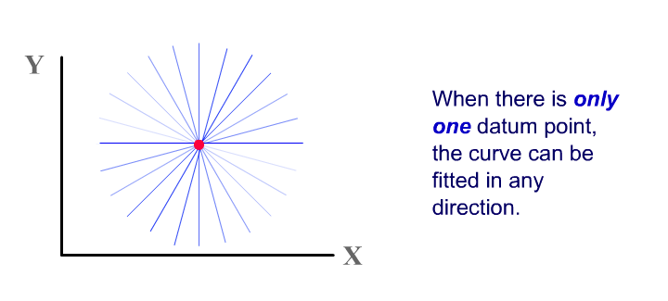


Slide 7
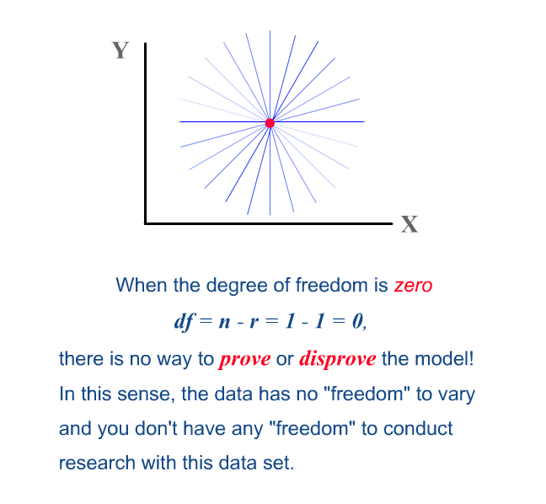

Slide 8
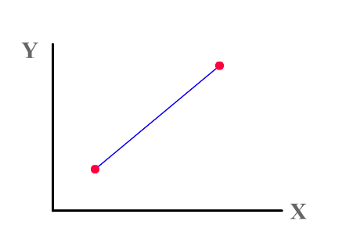


Slide 9


Slide 10


Slide 11
DF = 2 – 1 = 1. This is a bit better than the previous model, which has one datum point and no degree of freedom. However, it is still undesirable.
If DF = 1 and the fit is perfect, there is no room (freedom) for other plausible alternate models. Again, this model is “always right” and cannot be falsified.

Slide 12
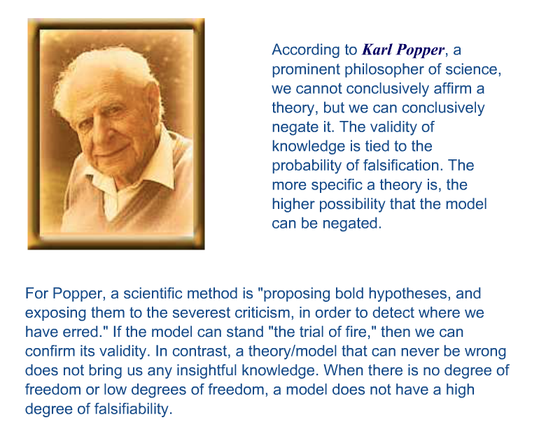

Slide 13
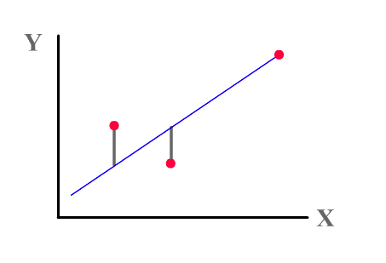


Slide 14
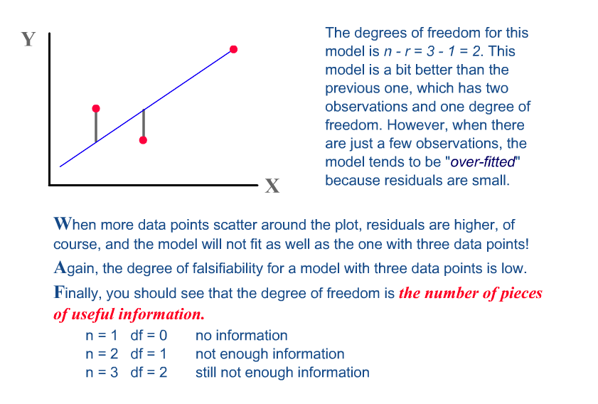

Slide 15
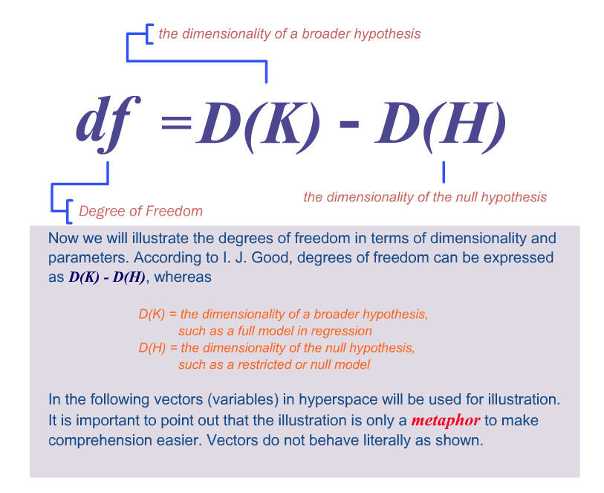

Slide 16
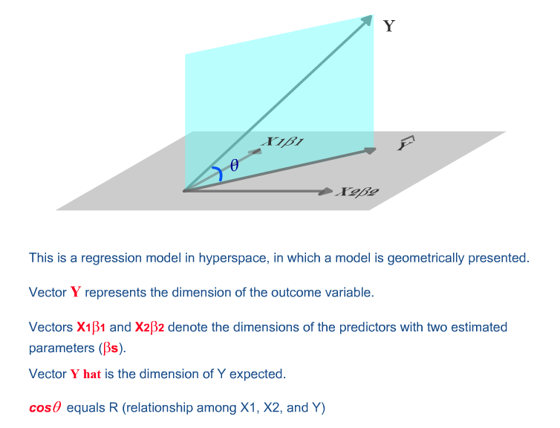

Slide 17
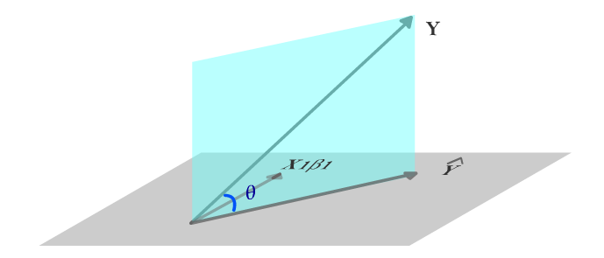


Slide 18
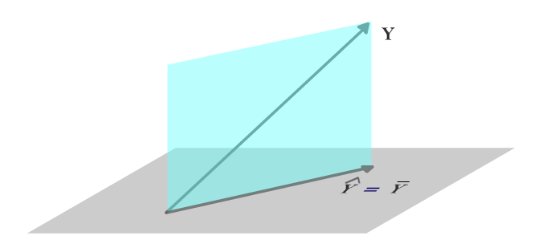


Slide 19
The right answer is “none.” In a null model, the number of parameters to estimate is zero. The expected Y score is equal to the mean of Y. There is no beta weight (regression coefficient or slope) to be estimated.

Slide 20
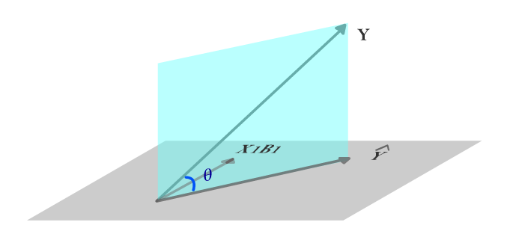


Slide 21


Slide 22
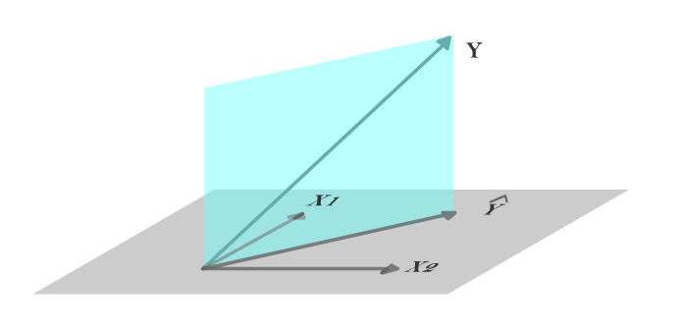


Slide 23


Slide 24
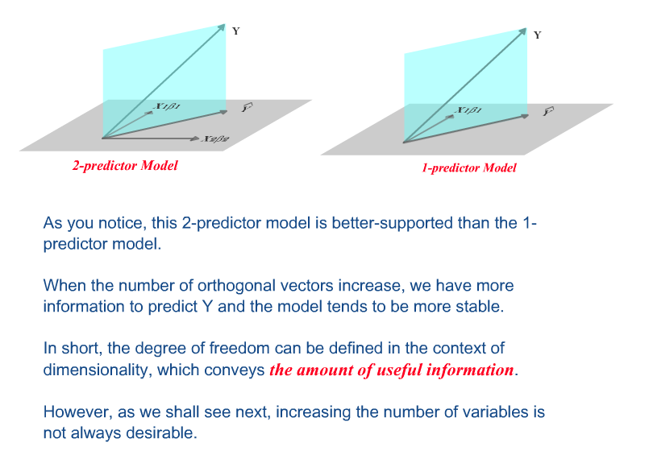

Slide 25
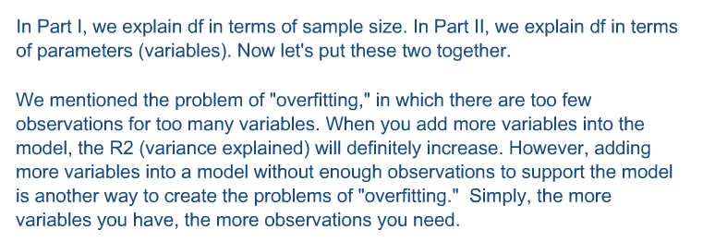

Slide 26


Slide 27
