Slide 1
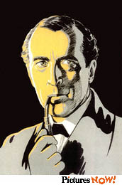
Unit 2: Exploratory data analysis
Detective Chong Ho (Alex) Yu

Slide 2
What isn't EDA
EDA does not mean lack of planning or messy planning.
  “I don't know what I am doing; just ask as many questions as possible in the survey; I don't need a well-conceptualized research question or a well-planned research design. Just explore.”
EDA is not fishing or p-hacking
EDA is not opposed to confirmatory data factor (CDA) e.g. check assumptions, residual analysis, model diagnosis.

Slide 3
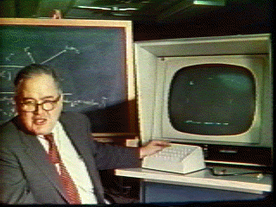
What is EDA?
A philosophy about how data analysis should be carried out, rather than being a fixed set of techniques.
Pattern-seeking
Skepticism (detective spirit)
Abductive reasoning
John Tukey (not Turkey): Explore the data in as many ways as possible until a plausible story of the data emerges (Like a detective).
The precursor of data mining

Slide 4
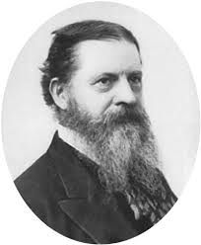
Abduction
Introduced by Charles Sanders Pierce.
  The surprising phenomenon, X, is observed.
  Among hypotheses A, B, and C, A is capable of explaining X.
  Hence, there is a reason to pursue A

Slide 5
Abduction
At most, abduction could provide a conjecture or a potential hypothesis A to pursue, but it would not confirm or disconfirm A
Inference to the best explanation (IBE): similar to abduction, modified by Harmon. But it is not the same.
After inquiry, we found multiple competing theories that can explain the phenomenon. Pick the best one!
Criterion: most explanatory power

Slide 6


IBE: Pick the best!
It is like that you interviewed ten persons from e-harmony or Christian Mingle, and then you pick the best one to be your wife/husband.

Slide 7
Elements of EDA
Velleman & Hoaglin (1981):
  Residual analysis
  Re-expression (data transformation)
  Resistant
  Display (revelation, data visualization)

Slide 8
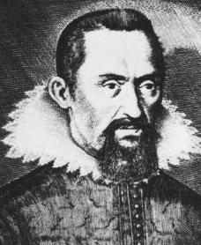
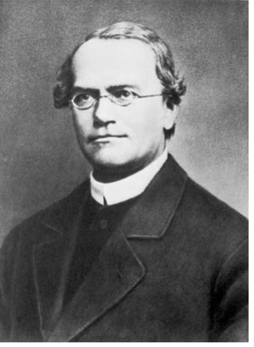
Residual
Data = fit + residual
Data = model + error
Data = signal + noise
Residual is a modern concept.
In the past many scientists ignored it. They reported the “fit” only
  Johannes Kepler
  Gregor Mendel
  Arthur Eddington

Slide 9
Johnannes Kepler (1571-1630)
Proposed that the earth and other planets orbit around the sun in an elliptical fashion.
Kepler worked under another well-known astronomer, Brahe, who collected a huge database of planetary orbits. Using Brahe's data, Kepler found data to fit into the elliptical hypothesis.
Almost 400 years later when William Donahue redid Kepler's calculation and found that the orbit data and the elliptical model do not fit each other as claimed.

Slide 10
Gregor Mendel (1824-1884)
The founder of modern genetics
Physical properties of species are subject to heredity.
Mendel conducted a fertilization experiment to confirm his belief.
R. A. Fisher (1936) questioned the validity of Mendel's study. Fisher pointed out that Mendel's data seemed "too good to be true."
Using Chi-square tests, Fisher found that Mendel's results were so close to what would be expected that such agreement could happen by chance less than once in 10,000 times.

Slide 11
Arthur Eddington (1882-1944)
Substantiated Einstein’s theory of general relativity by observing the positions of stars during the 1919 solar eclipse.
In the 1980s scholars found that Eddington did collect sufficient data to reach a conclusion. Rather, he distorted the result to make it fit the theory.
Did they falsify data? Not necessary. They might not understand every model could have residuals.

Slide 12
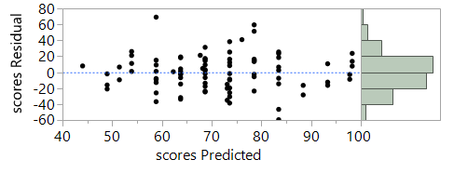
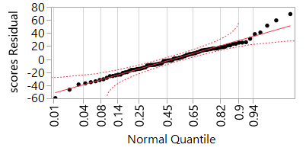
Random residual plot
Ideally speaking, no systematic pattern
Normal distribution
The mean of residuals is close to zero.

Slide 13
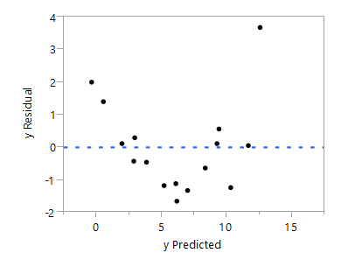
Strange residual patterns
Non-random, systematic
Check the data!

Slide 14
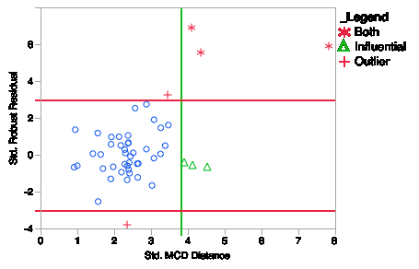
Robust residual
Robust regression in SAS
The residual plot tags the influential points (less severe) and outliers (more severe).

Slide 15
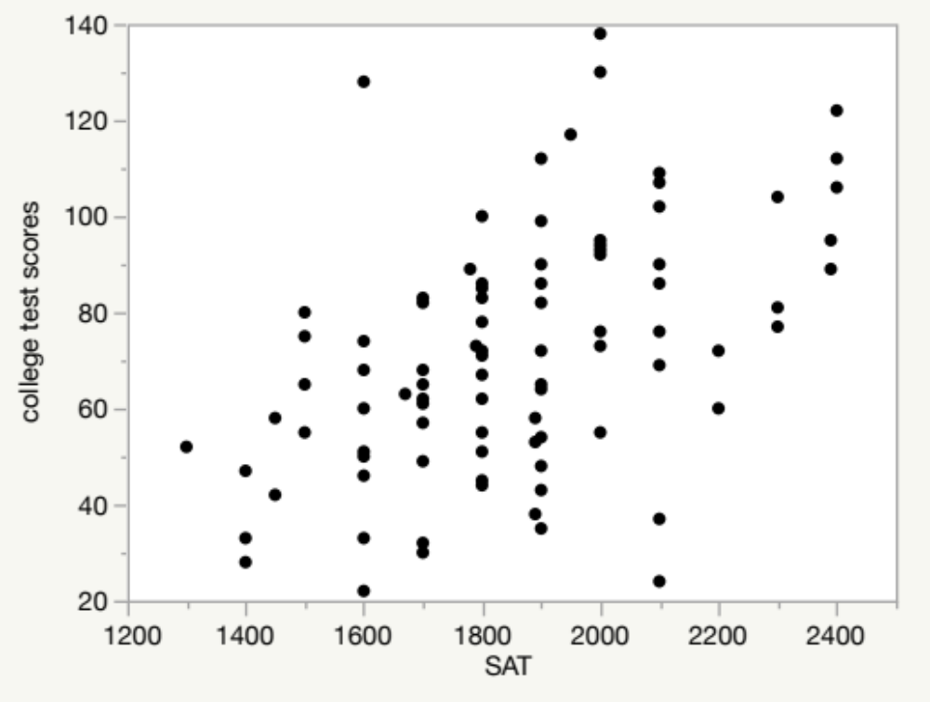
Example
Download and open “visualization_data.jmp”
Can SAT predict college academic performance?
Open Analyze from the pull down menu
Put SAT into X and college test scores into Y, Press OK
Until SPSS, SAS/JMP shows the scatterplot: It forces you to check the data pattern.
Contextual menu

Slide 16
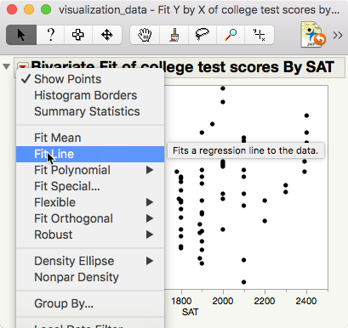
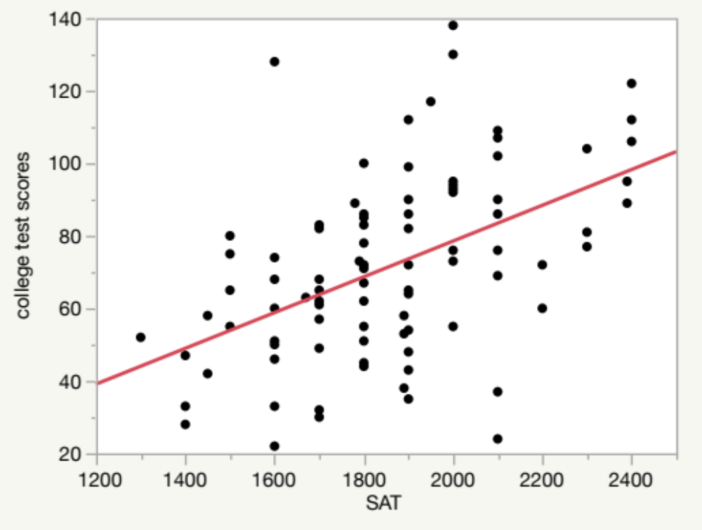

Slide 17
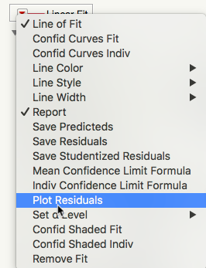
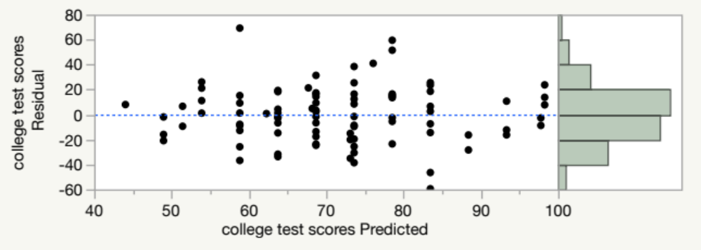
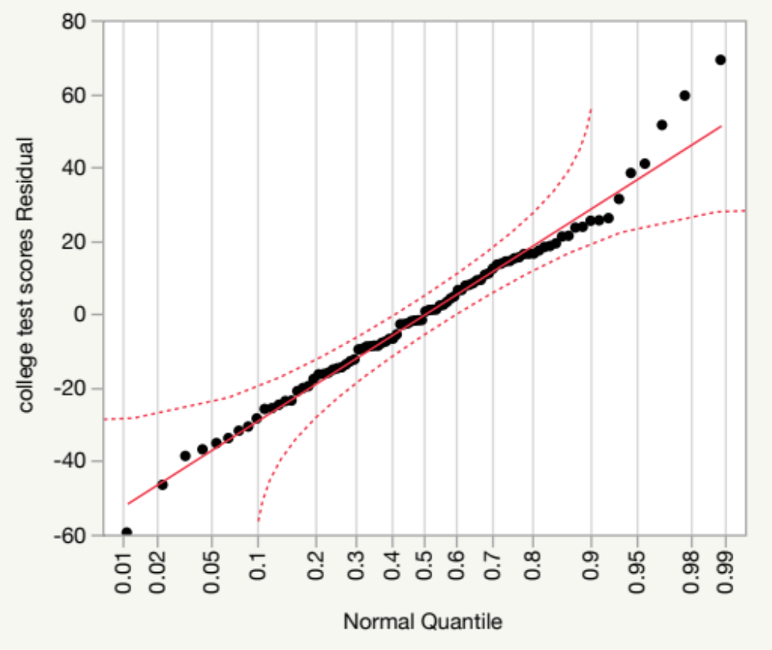

Slide 18
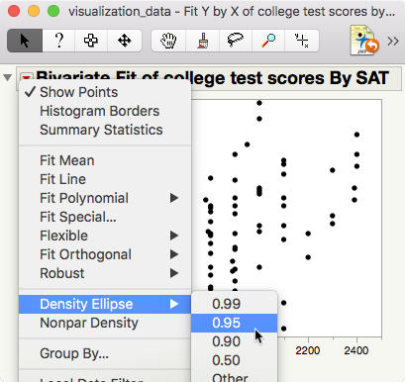
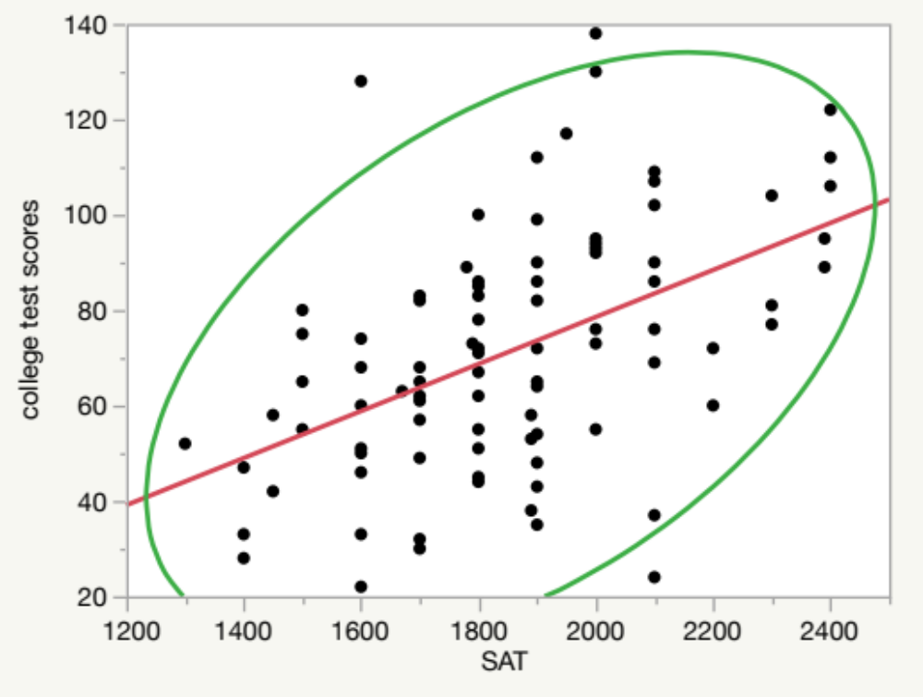
95% density ellipse: Assume bivariate normality, stretching from the centroid the ellipse covers 95% of the data. The data points outside the coverage are considered outliers.

Slide 19
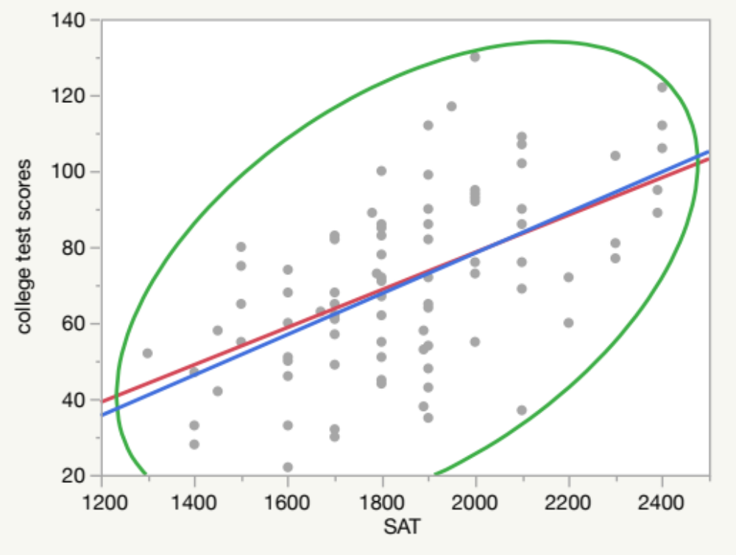
Example
Click on the extreme case.
Hold down the control key and select all three one by one.
Right-click on the extreme cases, select Row Hide and Exclude.
Choose Fit Line again from the reversed red triangle.

Slide 20
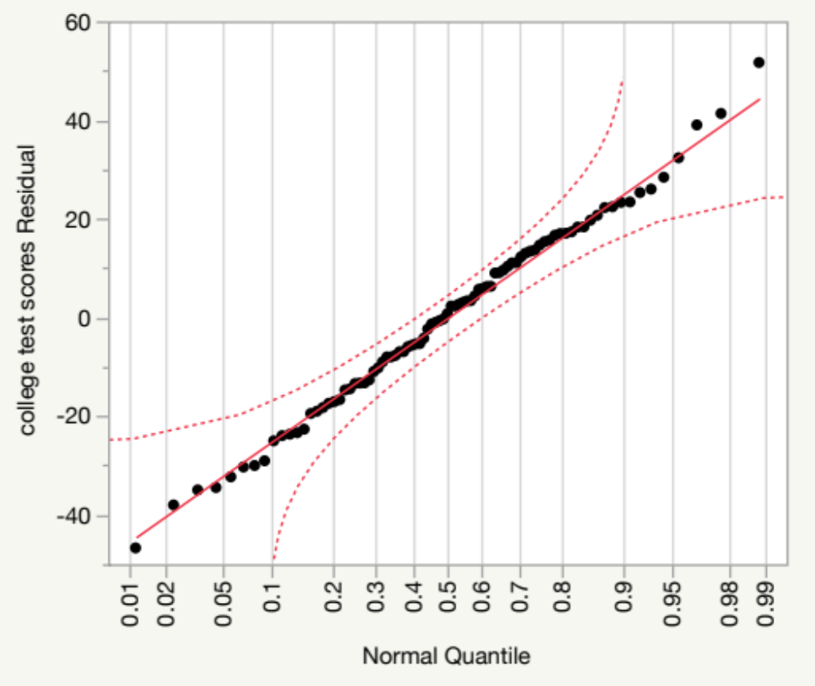
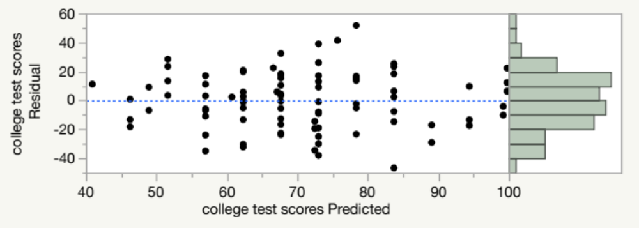
Example
Choose Plot Residuals from the Second Linear Fit.
Now are the residuals better?

Slide 21
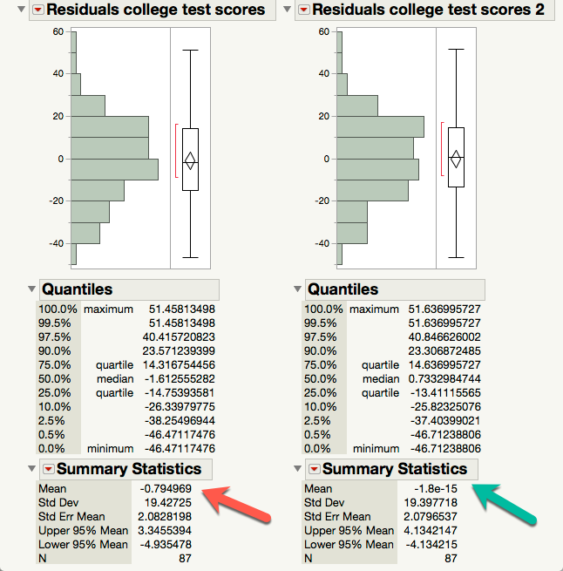
Example
The normal quantile plot should be sufficient. But if you are a perfectionist, you can output the residuals from the two linear fits into data columns
Select both residuals, choose Distribution from Analyze, and press OK.
SAS.JMP use the e-notation. The mean of the second residuals is closer to zero.

Slide 22
Assignment 1
Download and open visualization_data.jmp
Choose Fit Y from X from the pull down menu Analyze
Put SAT into X and college test scores into Y
Press OK
From the inversed red triangle choose Density Ellipse: .99
How many outlier(s) is/are identified?
Remove the outlier(s) and run a regression model by choosing Fit Line
Run a residual diagnosis by choosing Plot Residuals from Linear Fit.
Save the result by choosing Save script to data table from the reversed red triangle.
Is this one better than the previous two models?

Slide 23
Re-expression or transformation
Parametric tests require certain assumptions e.g. normality, homogeneity of variances, linearity...etc.
When your data structure cannot meet the requirements, you need a transformer (ask Autobots, not Deceptions)!

Slide 24
Transformers!
Normalize the distribution: log transformation or inverse probability
Stabilize the variance: square root transformation: y* = sqrt(y)
Linearize the trend = log transformation (but sometime it is better to use nonlinear fit, will be discussed later)

Slide 25
Log transformation
Logarithm is the inverse of exponential (raise power)
10 raises power to 3 is 10³: 10X10X10 = 1,000
The log base can be any integer. It could be log2, log5, log10.
Log2(64) = 6 because 64 = 2⁶ = 2X2X2X2X2X2
Log() is called natural log
Log10 is called common log

Slide 26
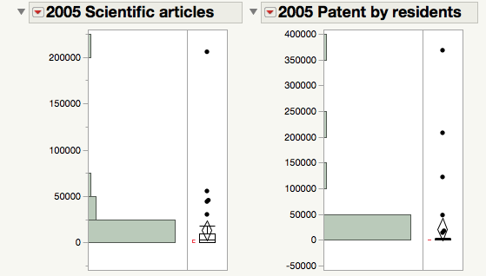
Skewed distribution
Open Worldbank_data.
I want to know whether publication of scientific studies and patents can predict GDP per worker.
The distributions of publication of scientific studies and patents are skewed. A few countries (e.g. US, Japan, Korea) have the most.
But I cannot remove these “outliers” because they are major nations.

Slide 27
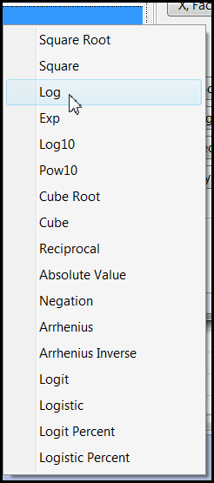
Solution: Data transformation
You can create the transformed variable while doing analysis by right-clicking the original variable.
Faster, but will not store the new variable.
You cannot preview the distribution.

Slide 28
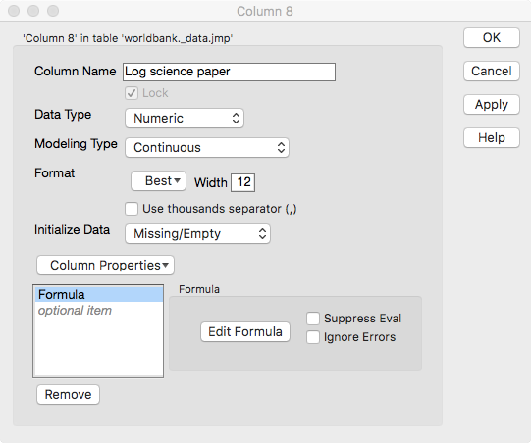
JMP
Create a permanent new variable for re-analysis later.
Double-click on a new column.
Choose Formula in Column properties.
Click Edit formula.

Slide 29
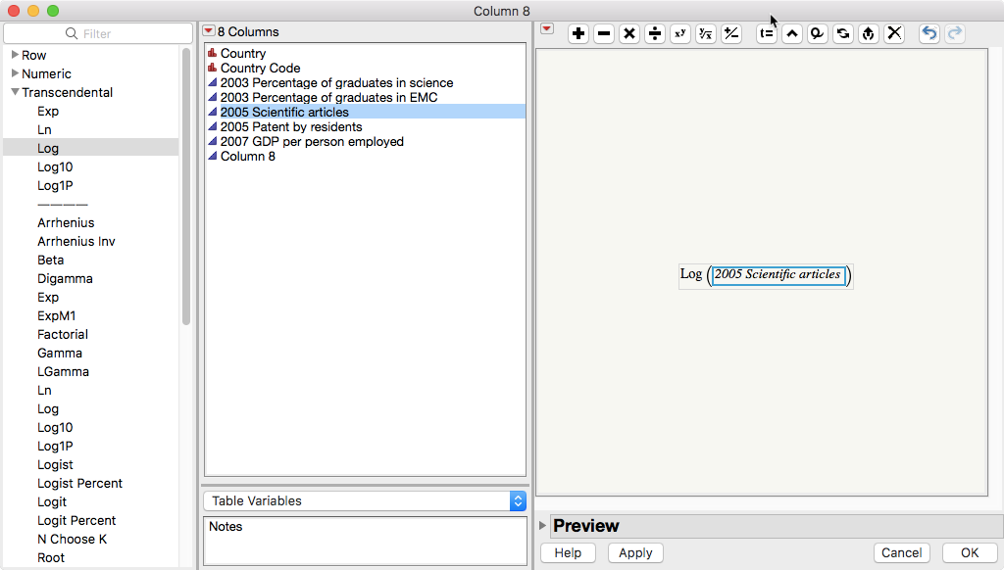

Slide 30
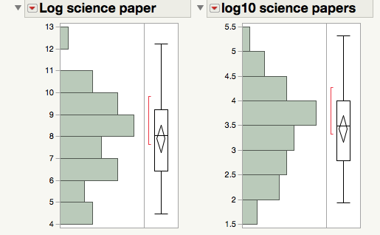
Explore different transformation options
The key of exploratory data analysis is: Explore!
I tried both log and log10 transformation
Log10 is better

Slide 31
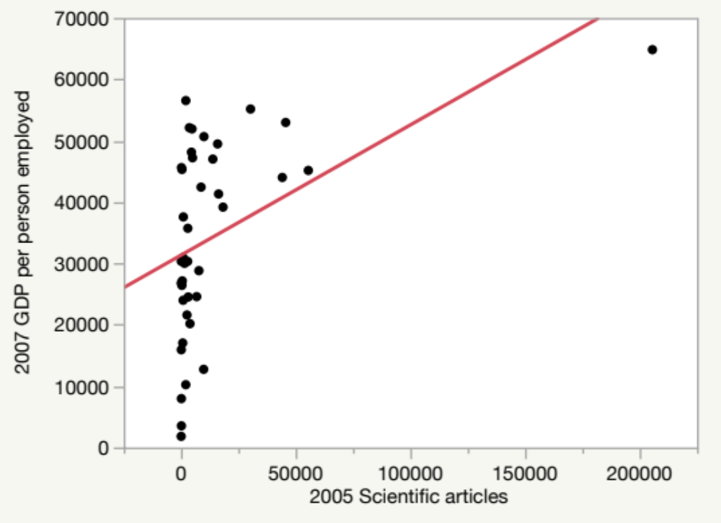
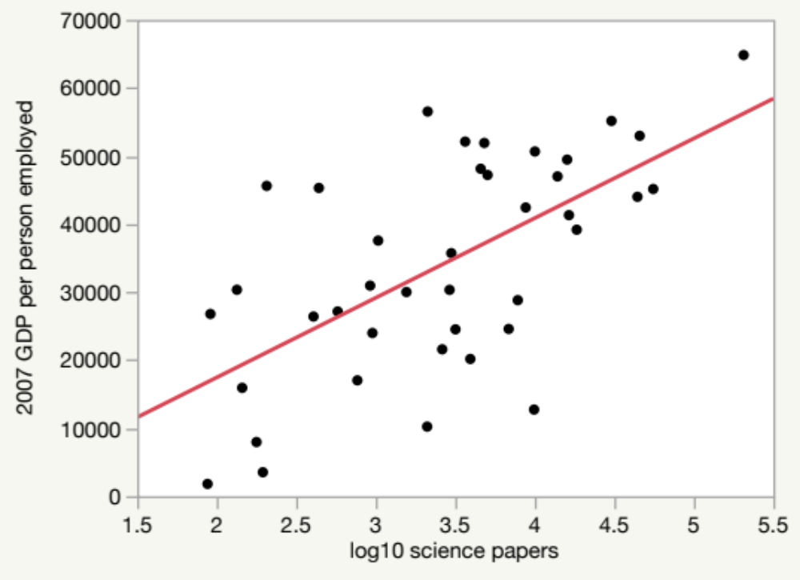
Before and after
Regression with transformed variables makes much more sense!

Slide 32
Assignment 2
Use the same data set “Wordlbank_data.jmp”
Try different transformation options for 2005 patents by residents.
Pick the best transformed variable to predict 2007 GDP per person employed. Log, log10, or something else?

Slide 33
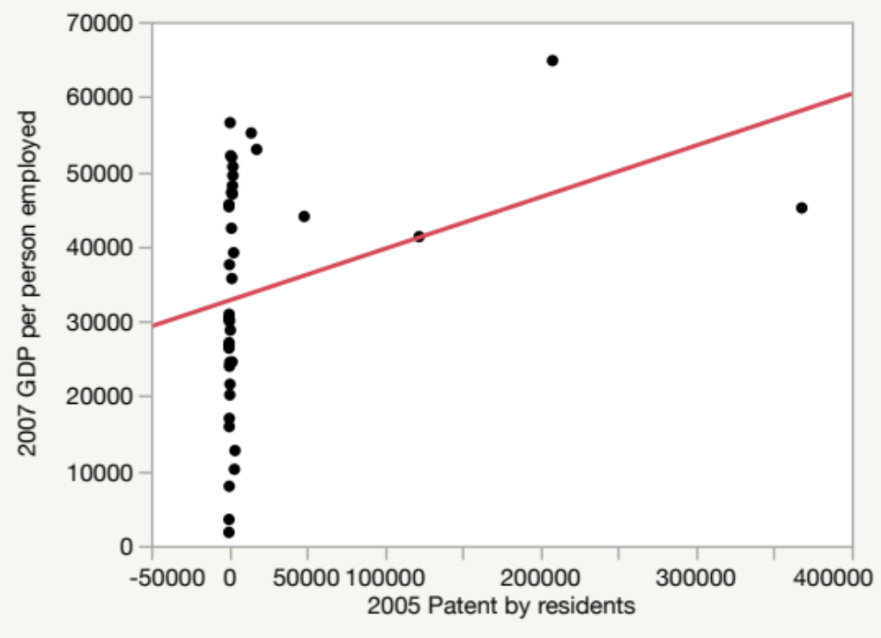
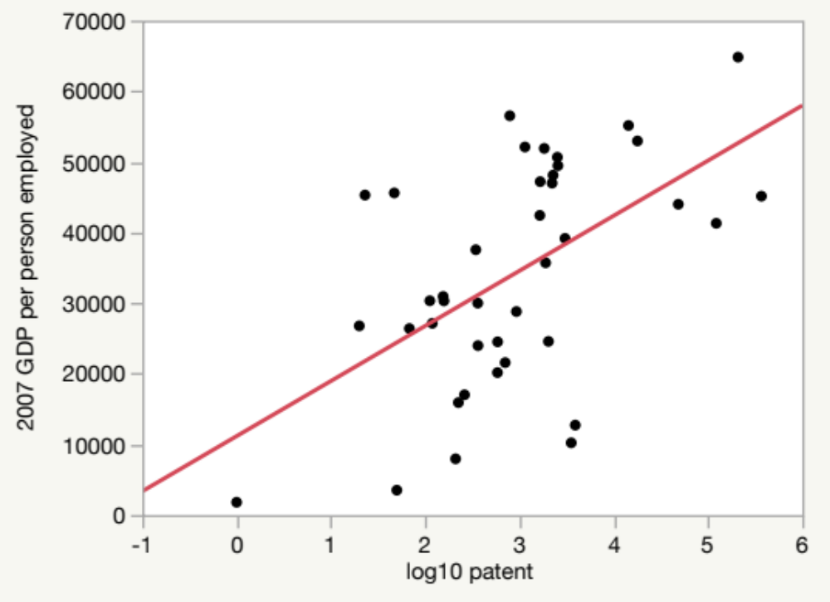
Before and after
Regression with transformed variables makes much more sense!

Slide 34
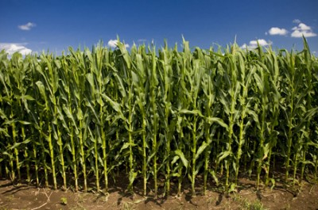
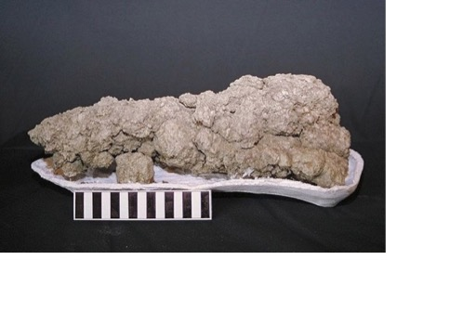
Example from JMP
Sample data set “Corn.jmp” (under Nonlinear modeling)
DV: yield
IV: nitrate

Slide 35
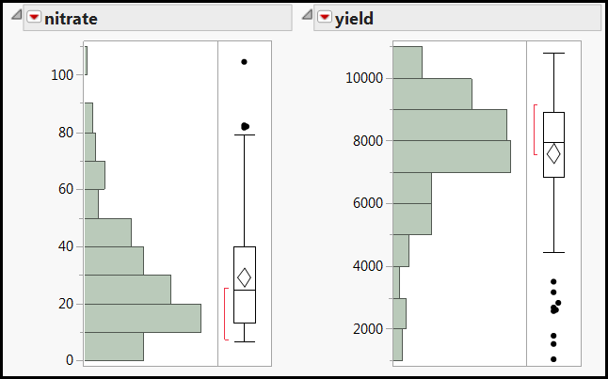
Skewed distributions
Both DV and IV distributions are skewed. What regression result would you expect?

Slide 36
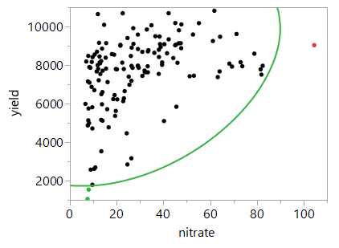
Remove outliers?
Three observations are located outside the boundary of the 99% density ellipse (the majority of the data)
Only one is considered an outlier.

Slide 37
Remove outliers?
Removing the two observations at the lower left will not make things better.
They fall along the nonlinear path.

Slide 38
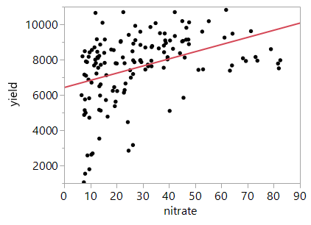
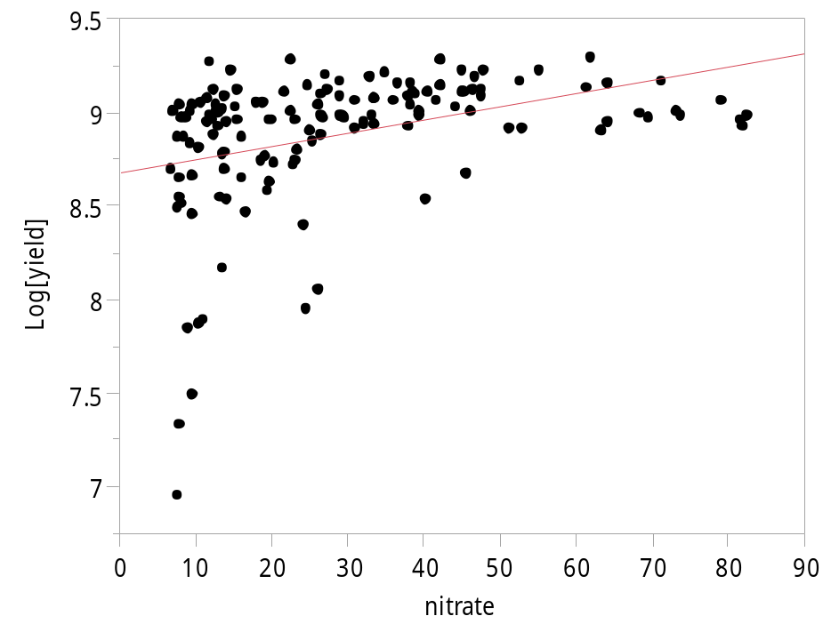
Transform yield only
Remove the outlier at the far right.
It didn't look any better.

Slide 39
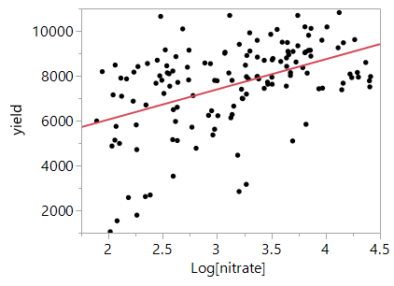
Transform nitrate only
The regression model looks linear.
It is acceptable, but the underlying pattern is really nonlinear.

Slide 40
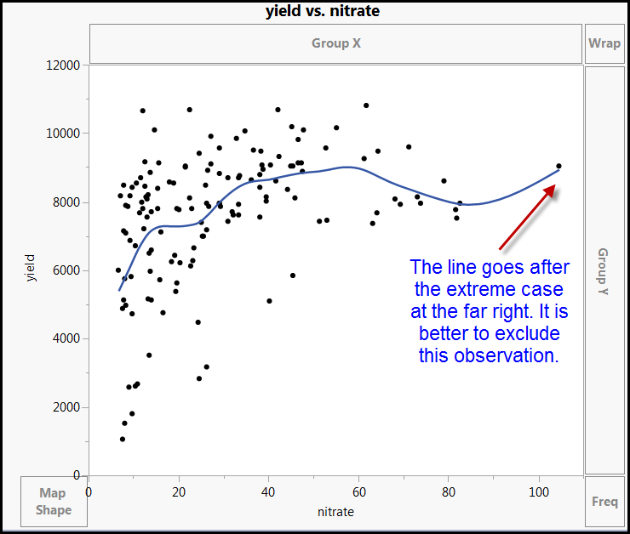
Graph Builder: Interactive nonlinear fit

Slide 41
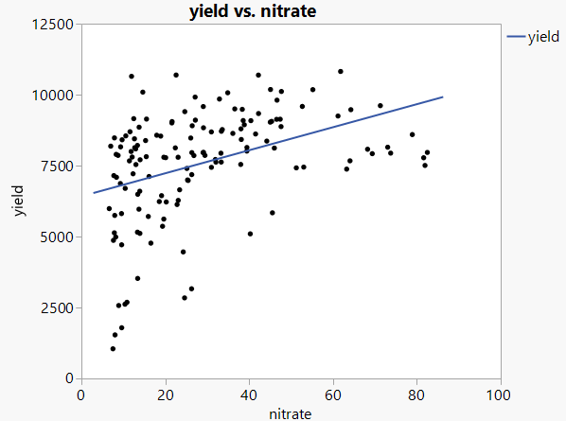
Linear model is too simplistic and underfit

Slide 42
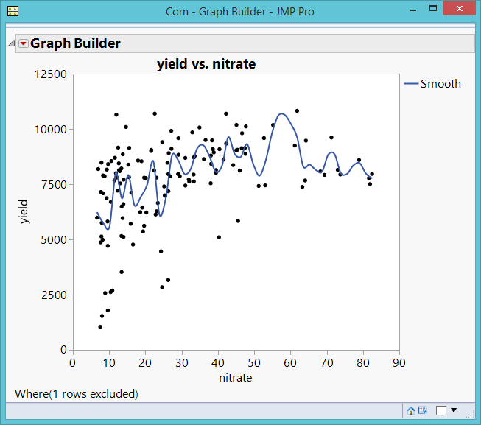
Overfit and complicated model

Slide 43
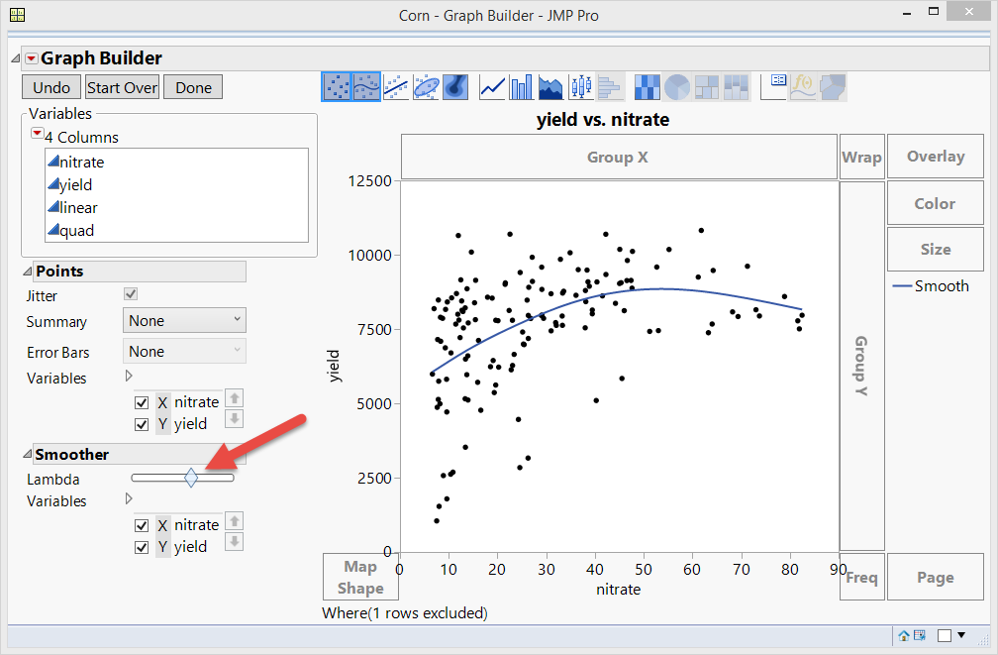
Smooth things out: Almost right
Lambda: Smoothing parameter
Not a bad model, but the data points at the lower left are neglected.

Slide 44
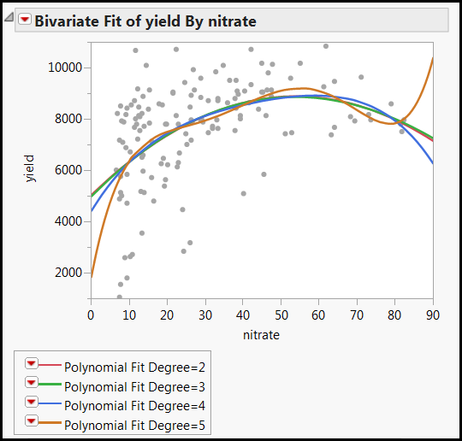
Fit polynomial (nonlinear fit)
Quadratic = 2 turns
Cubic = 3 turns
Quartic = 4 turns
Quintic = 5 turns, take the lower left into account, but too complicated (too many turns)

Slide 45
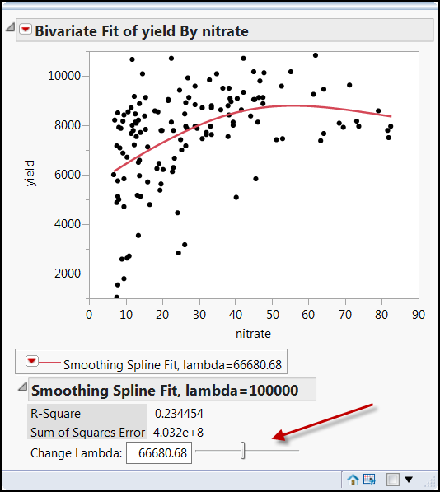
Fit spline
Flexible: Fit Spline
Like Graph Builder, in Fit Spline you can control the curve interactively.
It shows you the R-square (variance explained), too.
It still does not take the lower left data into account.

Slide 46
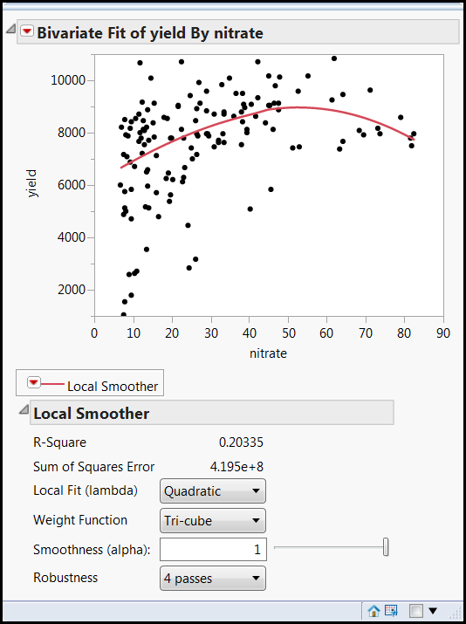
Kernel Smoother
Local smoother: take localized variations and patterns into account.
Interactive, too
But the line still does not go towards the data points at the lower left.

Slide 47

No data points left behind!

Slide 48
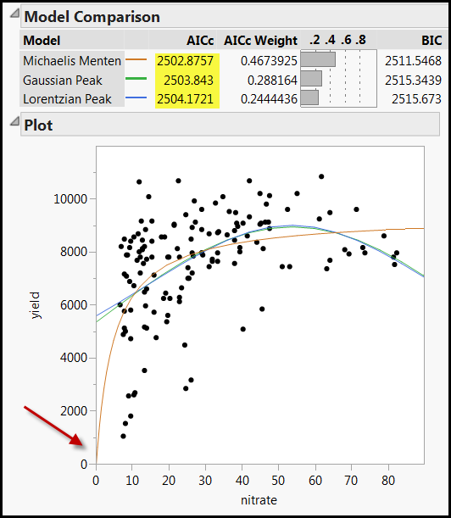
Fit Curve
Specialized modeling: Fit curve
MM has the lowest AICc and it takes the data points at the lower left into account. Should we take it?
MM is a specific model of enzyme kinetics in biochemistry.

Slide 49
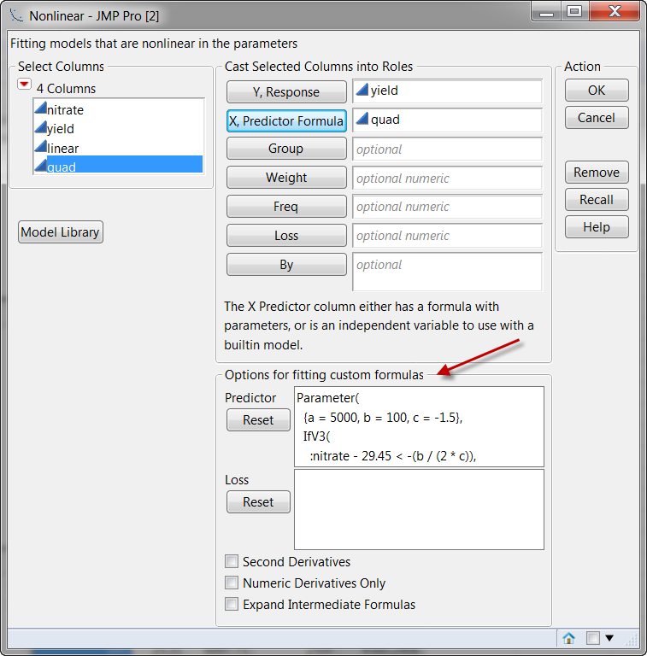
Fit nonlinear
Specialized modeling: Nonlinear
Custom-made formula for data transformation.
You need prior research to support it. You cannot makeup a transformation or an equation.

Slide 50
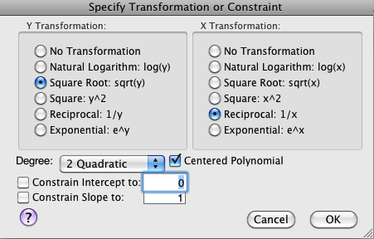
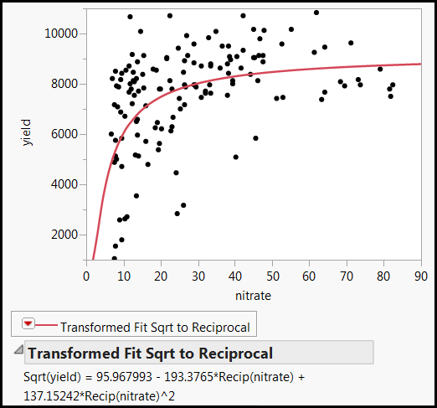
Fit special
It works! Now the line passes through all data points! Yeah!

Slide 51

I am the best transformer!

Slide 52
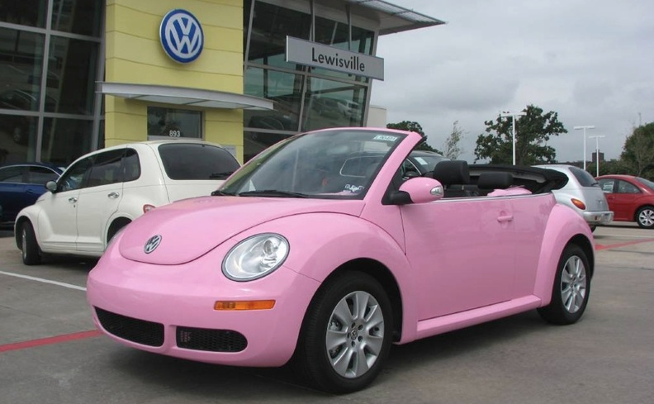
Assignment
Transform yourself into a Pink Volkswagen or a GMC truck.

Slide 53
Caution! Different to interpret
Osborne (2002) advises that transformation should be used appropriately;
Many transformations reduce non-­normality by changing the spacing between data points, but this raises issues in data interpretation.
If transformations are done correctly, all data points should remain in the same relative order as prior to the transformation. In this way the interpretation of the scores is not affected.
It might be problematic if the original variables were meant to be interpreted directly, such as annual income and age. After the transformations, the new variables may become significantly more complex to interpret.

Slide 54
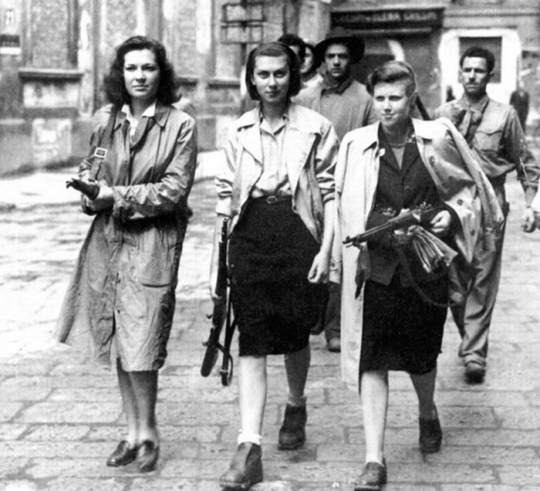

Resistance
Resistance is not the same as robustness.
Resistance: Immune to outliers
Robustness: immune to parametric assumption violations
Use median, trimean, winsorized mean, trimmed mean to countermeasure outliers, but it is less important today (will be explained next).

Slide 55
Data visualization: Revelation
Today some people still refuse to use graphing methods. Data visualization is the primary tool of EDA. Without “seeing” the data pattern,...
  how can you know whether the residuals are random or not?
  how can you spot the skewed distribution, nonlinear relationship, and decide whether transformation is needed?
  how can you detect outliers and decide whether you need resistance or robust procedures?
DV will be explained in detail in the next unit.

Slide 56

Data visualization
One of the great inventions of graphical techniques by John Tukey is the boxplot.
  It is resistant against extreme cases (use the median)
  It can easily spot outliers.
  It can check distributional assumption using a quick 5-point summary.

Slide 57

Data visualization
Boxplot can be used in median-smoothing when there are too any data.
These are 14,819 responses to the Consideration of Future Consequences Scale (CFCS).
When the n is huge, even random numbers might appear to be good.
To demonstrate the problem, Q13 and Q14 are randomly generated.
The Cronbach Alpha looks good! No bad items!

Slide 58

Data visualization
Data visualization can distinguish patterns from noise.
Open Graph Builder
I want to know whether Q1 is strongly correlated with the total scale (Q2-Q14).
Q1 is not included into total because Q1 is correlated with itself.
Put Total without Q1 into Y
Put Q1 into X
Too many data points!

Slide 59

Data visualization
Change the display option to Boxplot.
Now the median of the total by each category of Q1 is shown.
There is a positive relationship between Q1 and all other items.

Slide 60

Data visualization
When I use median –smoothing to check the association between Q13 and total without Q13., it was found that there is no relationship.

Slide 61
Assignment 3
Download and open the data set “CFCS.jmp”
Open Graph Builder
Put Total without Q2 into Y
Put Q2 into X
Change the display to boxplot
Is there a strong relationship between Q2 and all other items (Total without Q2)?
Do the same to Total without Q14 and Q14
s there a strong relationship between Q14 and all other items (Total without Q14)?
Save both scripts to data tables

Slide 62
NIST Semantech’s Taxonomy of EDA
Some are overlapped and some are vague
  Maximizing insight
  Uncovering underlying structure
  Extracting important variables
  Detecting outliers and anomalies
  Testing underlying assumptions
  Developing parsimonious models
  Determining optimal factor settings

Slide 63
Issues of classical EDA taxonomies
Some classical EDA techniques are less important because today many new procedures...
  do not require parametric assumptions or are robust against the violations (e.g. decision tree, generalized regression).
  Are immune against outliers (e.g. decision tree, two-step clustering).
  Can handle strange data structure or perform transformation during the process (e.g. artificial neural networks).

Slide 64
Issues of classical EDA taxonomies
The classical taxonomy of is tied to both the attributes of the data (e.g., distribution, linearity, outliers, measurement scales, etc.) and the final goals (e.g., detecting clusters, patterns, and relationships).
However, understanding the attributes of the data is just the means instead of the ends.

Slide 65
Goal-oriented taxonomy of EDA
Detecting data clusters (the detail will be explained in the unit “Cluster analysis”)
Screening variables : e.g. Predictor screening (will be explained in the units about generalized regression, decision tree, bagging, and boosting)
Recognizing patterns and relationships (will be discussed in the unit about data mining: neural networks)

Slide 66
Predictor screening
2015 Programme for International Student Assessment (PISA)
USA and East Asian students only (n = 54978)
I want to know what factors can predict math performance
There are too many variables. I need preliminary screening (variable selection).
With this large sample size, running regression is problematic.
Analyze → Screening → Predictor Screening

Slide 67

Predictor screening

Slide 68

Predictor screening

Slide 69
EDA and data mining
Same:
  Data mining is an extension of EDA: it inherits the exploratory spirit; don't start with a preconceived hypothesis.
  Both heavily rely on data visualization.
Difference:
  DM: Use machine learning and resampling
  DM: More robust
  DM: Deal with much bigger sample size

