Slide 1

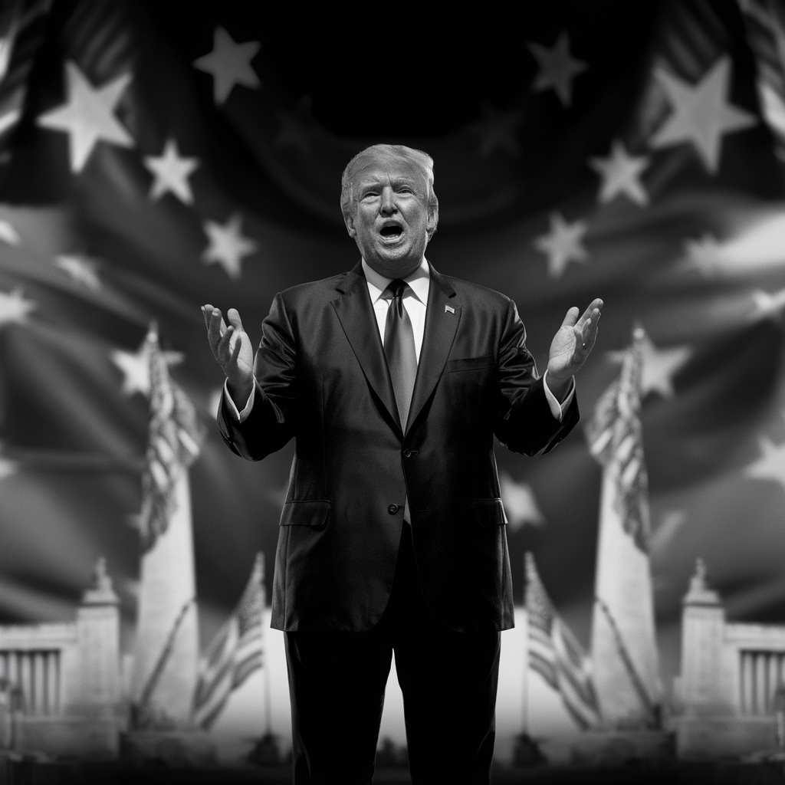
America First Movement: Then and Now
Living Grace Alliance Church’s Seminar
2024.10.24
Chong Ho Alex Yu

Slide 2
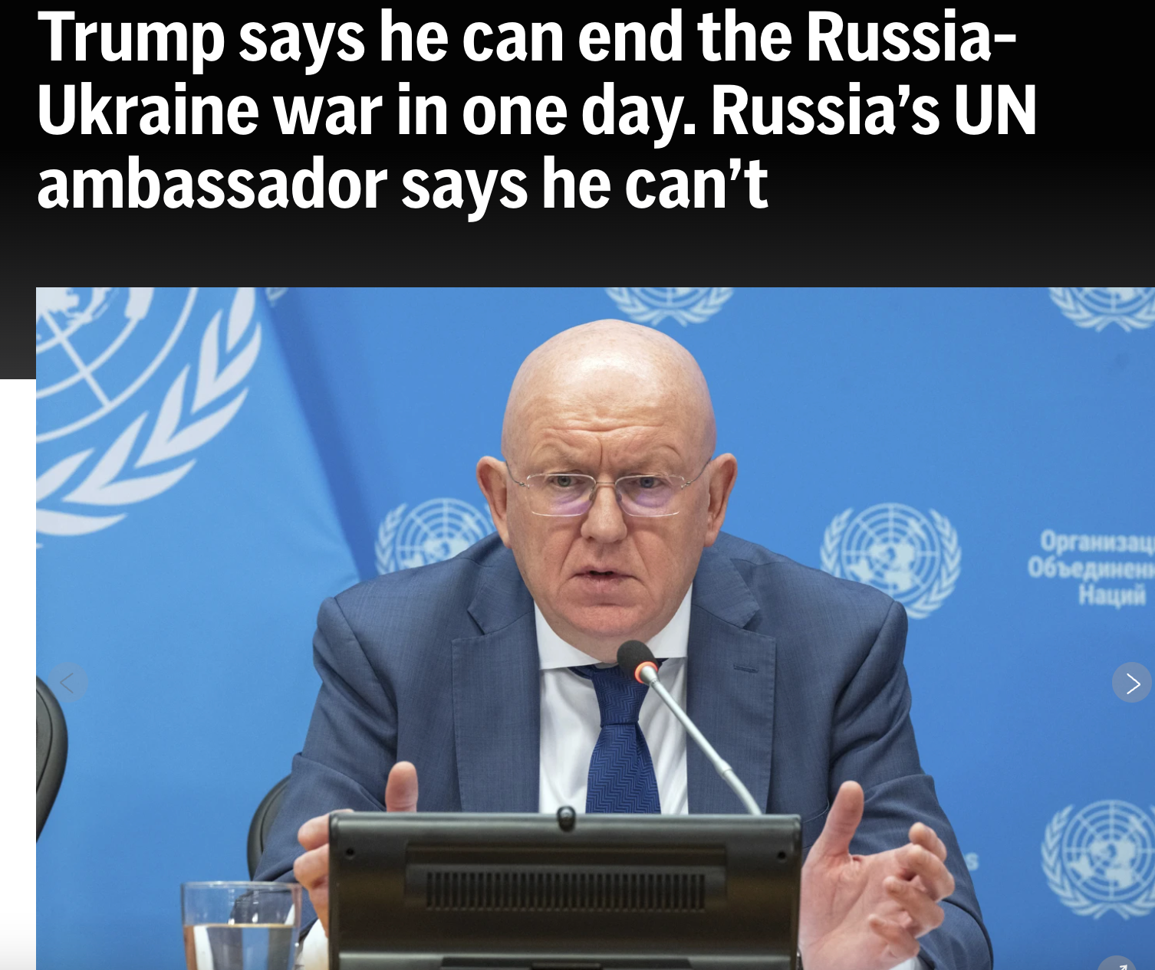

Slide 3
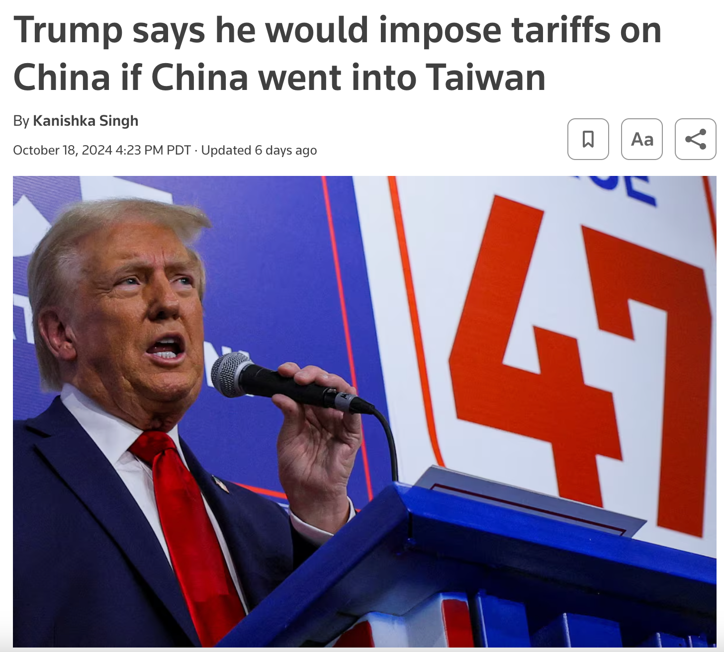

Slide 4

Section 1
Historical Context of the America First Movement

Slide 5
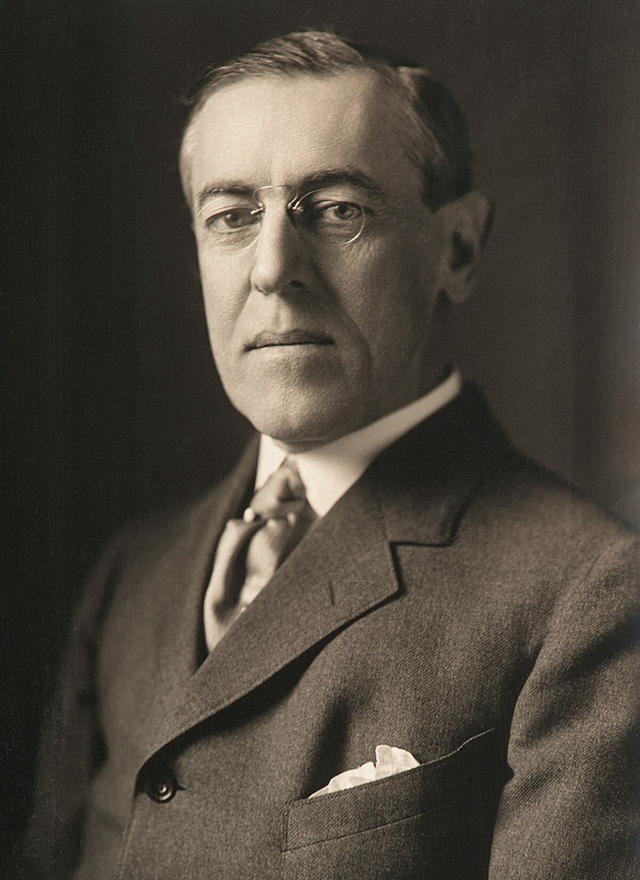
Origins of the America First Movement
The America First Movement was deeply influenced by the isolationist sentiments stemming from the aftermath of World War I and the economic hardships of the Great Depression.
Woodrow Wilson’s vision for World War I was rooted in a moral ideal: he wanted to make it "a war to end all wars." He believed that by reshaping the international order, the war could prevent future conflicts. Central to this vision was the League of Nations, an international organization aimed at fostering cooperation, peace, and mutual security among nations.
In the end, the U.S. did not join the League of Nations, reflecting a gap between Wilson’s internationalist ideals and the public’s isolationist sentiments.

Slide 6





The America First Committee and Its Influence
Domestic Focus Advocacy
Formation as a response to World War
The America First Committee was founded in September 1940 by Yale law students and quickly became a powerful organization.
The AFC effectively argued for prioritizing national resources on domestic issues, resonating with citizens concerned about economic stability and social welfare.
01
02
Membership Growth
Impact of Pearl Harbor
The AFC's membership surged to over 800,000, showcasing widespread public support for isolationist policies during a critical period in American history
03
04
The attack on Pearl Harbor drastically undermined the AFC's influence, leading to a rapid decline in its support and a shift towards a unified national war effort.

Slide 7

Key Figures and Their Contributions
Charles Lindbergh, already a national hero for his transatlantic flight in 1927, became the face of the isolationist movement. As a leading spokesperson for the America First Committee, Lindbergh delivered speeches across the country, arguing that America should not get involved in what he saw as a European problem.

Slide 8
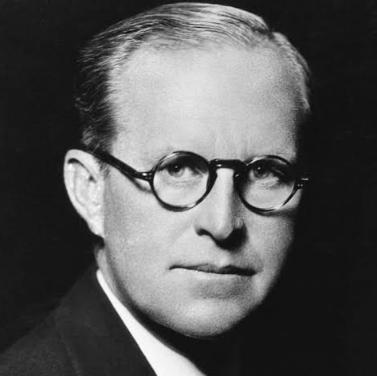
Key Figures
Joseph P. Kennedy: The father of future President John F. Kennedy, Joseph P. Kennedy served as the U.S. ambassador to the United Kingdom in the late 1930s. He was an outspoken advocate for appeasement and believed that Britain would lose to Nazi Germany. He also argued against U.S. involvement in the war, believing it would be disastrous for the country. His views caused friction with President Franklin D. Roosevelt, and he was eventually removed from his post in 1940.

Slide 9
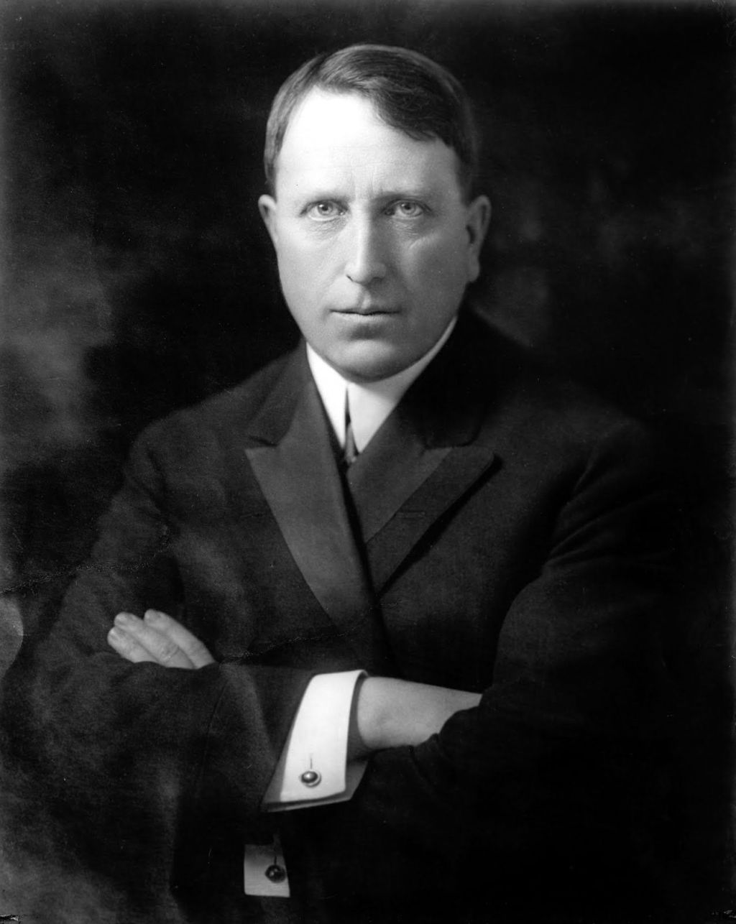
Key Figures
William Randolph Hearst, the powerful media tycoon behind Hearst Newspapers, was a vocal and direct supporter of isolationism. Through his extensive media empire, Hearst advocated for the U.S. to avoid involvement in European conflicts, using his newspapers to promote the idea that American interests were best served by staying out of World War II.

Slide 10
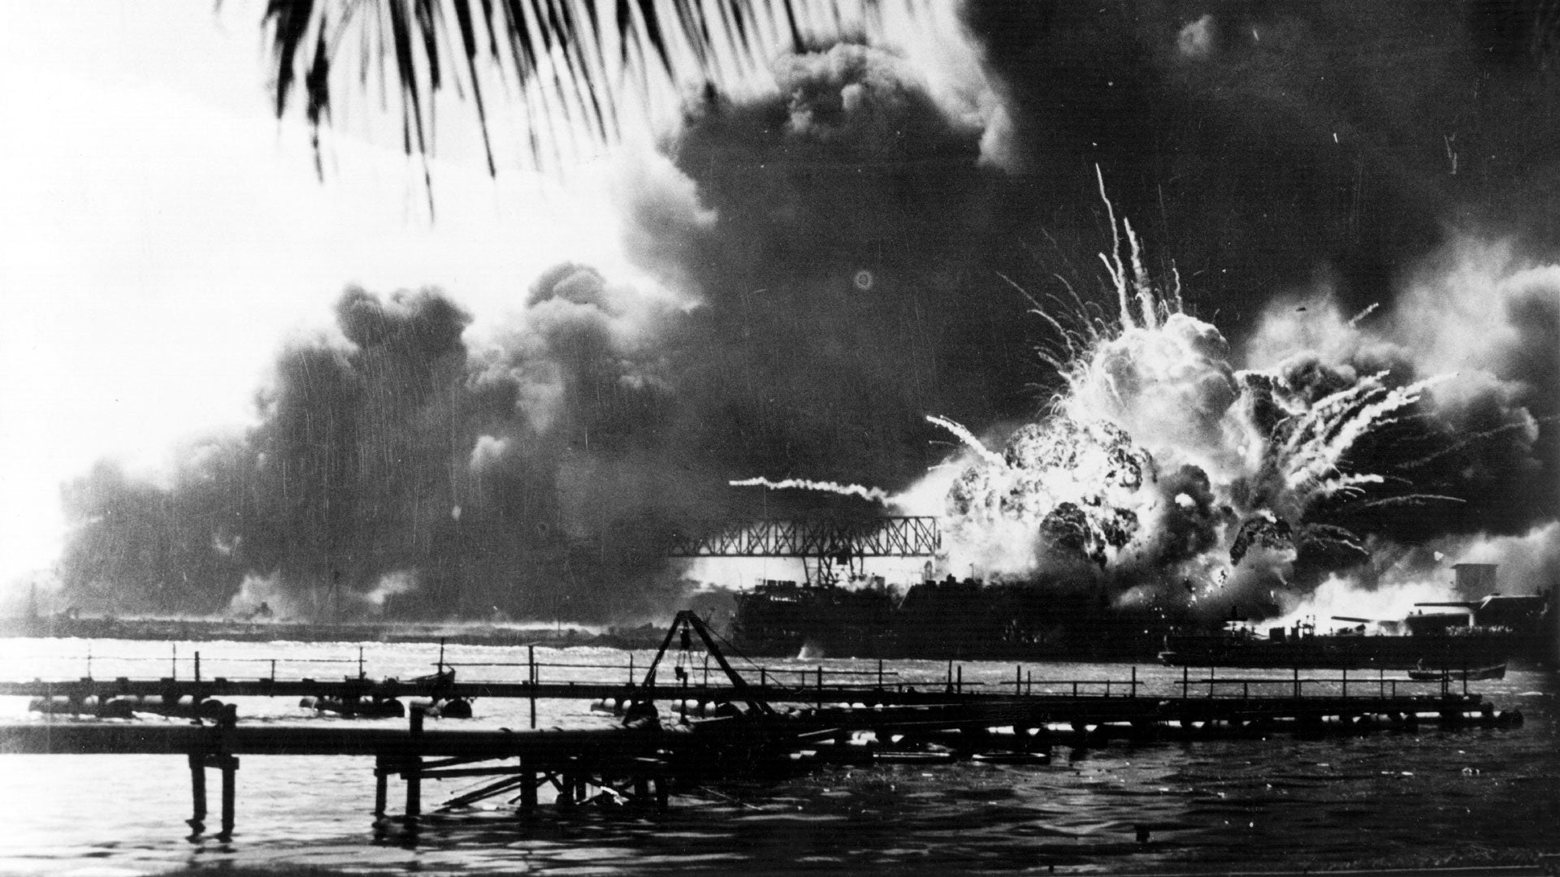
Decline of the Movement Post-Pearl Harbor
Shift in National Sentiment
The attack on Pearl Harbor catalyzed a dramatic transformation in American public opinion, leading to a near-universal support for military engagement and effectively nullifying the America First movement's isolationist arguments, as citizens rallied around the need for national unity and defense against external threats.

Slide 11
Section 2
Charles Lindbergh and Isolationism

Slide 12
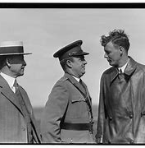
Lindbergh's Rise as a Spokesperson
Lindbergh’s speeches often blamed "warmongers" in Britain, Roosevelt's administration, and American Jews for pushing the country toward war.
In a particularly infamous speech in Des Moines, Iowa, on September 11, 1941, Lindbergh suggested that Jewish groups were agitating for war because they feared Nazi persecution in Europe. This rhetoric sparked widespread controversy and accusations of anti-Semitism.
Lindbergh’s views, which reflected the broader isolationist sentiment, were also rooted in his admiration for certain aspects of Nazi Germany, particularly their military prowess and technological advancements. He had visited Germany and met with Nazi officials in the 1930s, further complicating his image.
UK
Jews
FDR

Slide 13
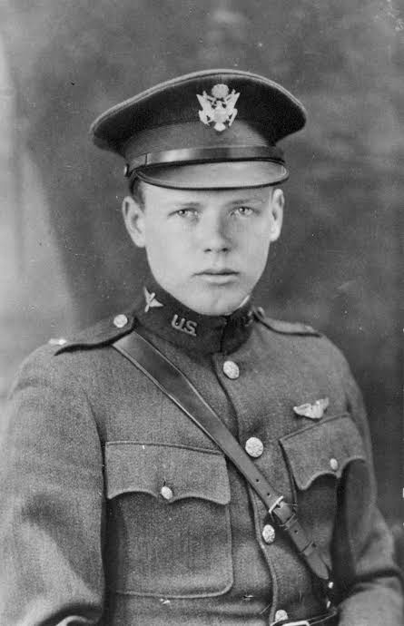
Controversial Rhetoric and Anti-Semitism
Impact on Public Discourse
Legacy of Division
The rhetoric employed by Lindbergh and the America First Committee contributed to the normalization of anti-Semitic sentiments, influencing public opinion and creating a legacy of exclusionary ideologies that persist in contemporary political discussions.
The America First movement's anti-Semitic undertones not only polarized public sentiment during its time but also left a lasting impact on American political culture, raising ongoing concerns about the resurgence of similar exclusionary narratives in modern discourse.

Slide 14
Lindbergh's Shift During WWII
Military Involvement**
Controversial Legacy**
Continued Advocacy**
1941
1943
1945
1
2
3
4
5
6
Pearl Harbor Attack**
1942
Public Support**
1944
Post-War Reflection**
1946

Slide 15

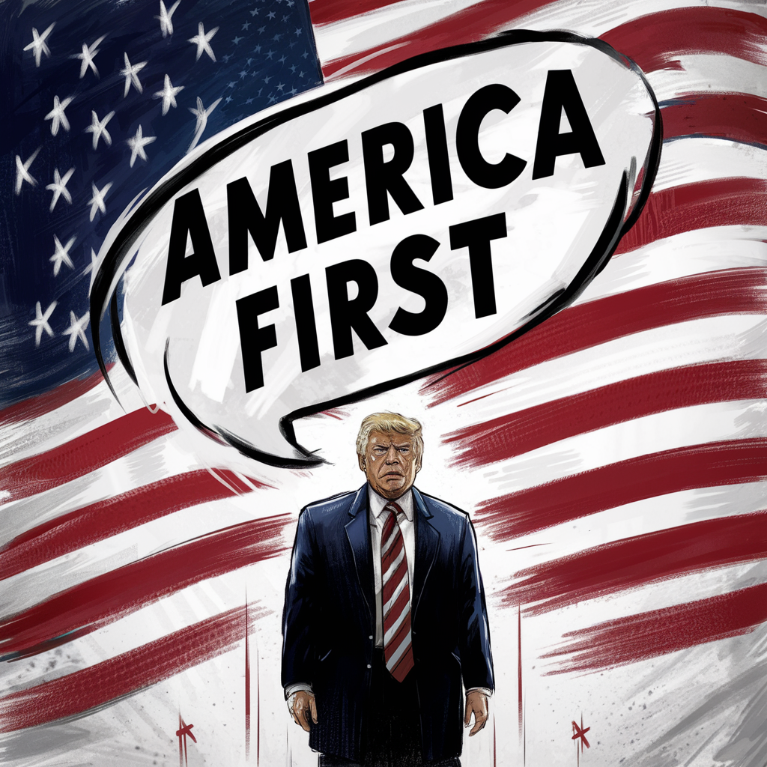
Section 3
The Modern "America First" Movement

Slide 16
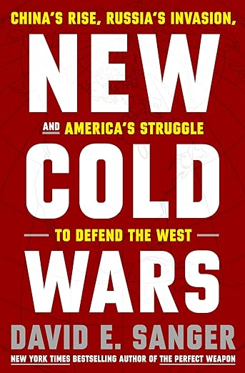
Donald Trump's Adoption of the Phrase
Trump's use of "America First" signifies a shift from historical isolationism to a modern form of economic nationalism, appealing to voters disillusioned by globalization and advocating for policies that prioritize American jobs and industries. Trump was not aware of AFC. Trump told Sanger,
“Which leader does not care for the country first?”
Economic protectionism: Trump pushed for policies that promoted American businesses and workers, such as renegotiating trade deals (e.g., replacing NAFTA with the USMCA) and imposing tariffs on China and other countries.
Opposition to globalism: Trump criticized international institutions like the United Nations, NATO, and various trade agreements that he believed undermined American sovereignty and economic interests.

Slide 17

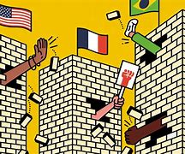
Immigration restriction: A focus on securing U.S. borders and reducing immigration, with an emphasis on national security and job protection for American citizens.
Donald Trump's Adoption of the Phrase
Peace through strength: While Trump criticized U.S. involvement in "endless wars," such as those in Iraq and Afghanistan, he did not advocate for complete non-interventionism. He often emphasized military strength and was willing to use force, as seen with targeted strikes in the Middle East. However, he wanted to avoid large-scale military engagements abroad unless absolutely necessary.

Slide 18

Shift from Isolationism to Nationalism
The contemporary "America First" movement emphasizes aggressive economic nationalism and protectionist policies, contrasting sharply with the original movement's focus on isolationism and non-interventionism,

Slide 19
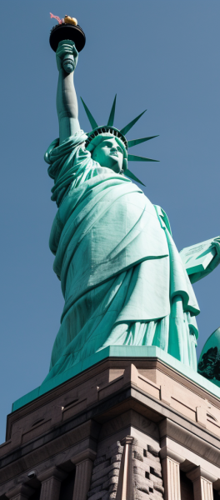
Foreign Policy Implications
Unilateral Foreign Relations
This philosophy encourages a shift towards unilateralism in foreign policy, favoring bilateral agreements that align closely with U.S. interests, potentially undermining multilateral cooperation.
Impact on Global Alliances
As the U.S. adopts a more isolationist stance, traditional alliances may weaken, prompting other nations to reassess their security strategies and diplomatic relationships with America.

Slide 20
Thank You
Contact: chonghoyu@gmail.com

