Slide 1
Art and Christianity
Living Grace Seminar (2024 May 2)
Chong Ho Yu

Slide 2
Why art?
Cultivating artistic taste through activities like visiting museums and reading literature can help develop spirituality in the Christian faith in several ways:
  Restore the sense of wonder and appreciate the world
  Reach the transcendental reality through symbolism
  Explore Biblical themes and reflect upon them
  Evoke emotion and stimulate thought, becoming more compassionate
  Inspire creativity and see things through a new perspective

Slide 3
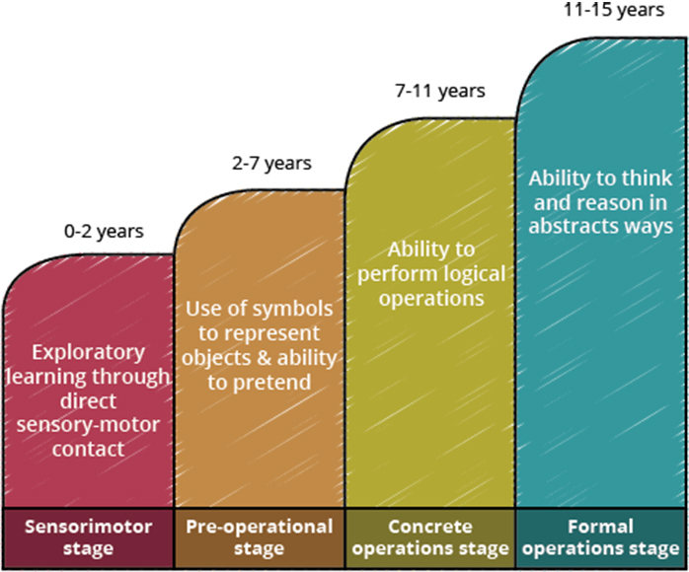
Sense of wonder
Exploring art and literature can enrich your grasp and admiration of the wonders of God's creation. Appreciating the beauty, complexity, and creativity expressed through various art forms can foster a sense of wonder and awe towards the divine.
Jean Piaget: Children are natural explorers.
Cognitive development
Image source: Roar media

Slide 4
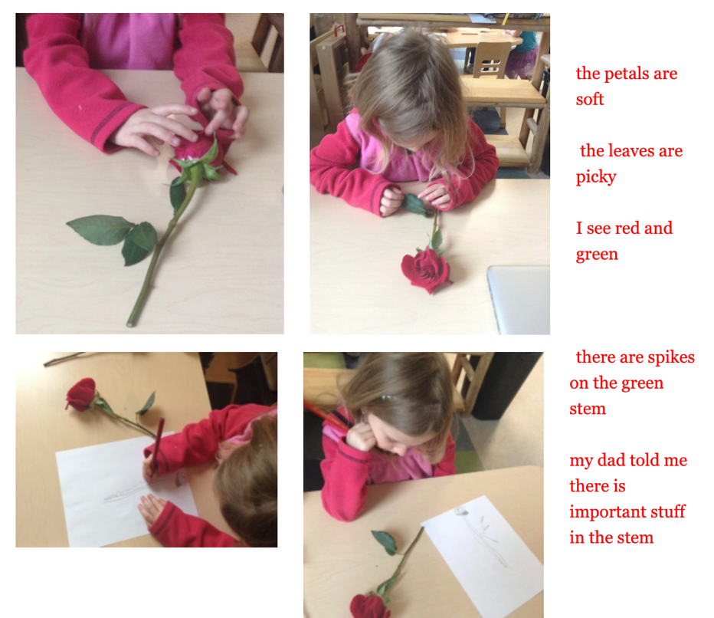
Sense of wonder
Tara Thall: “When children are invited to step into a relationship with an object, they begin to see, think and wonder.”

Slide 5
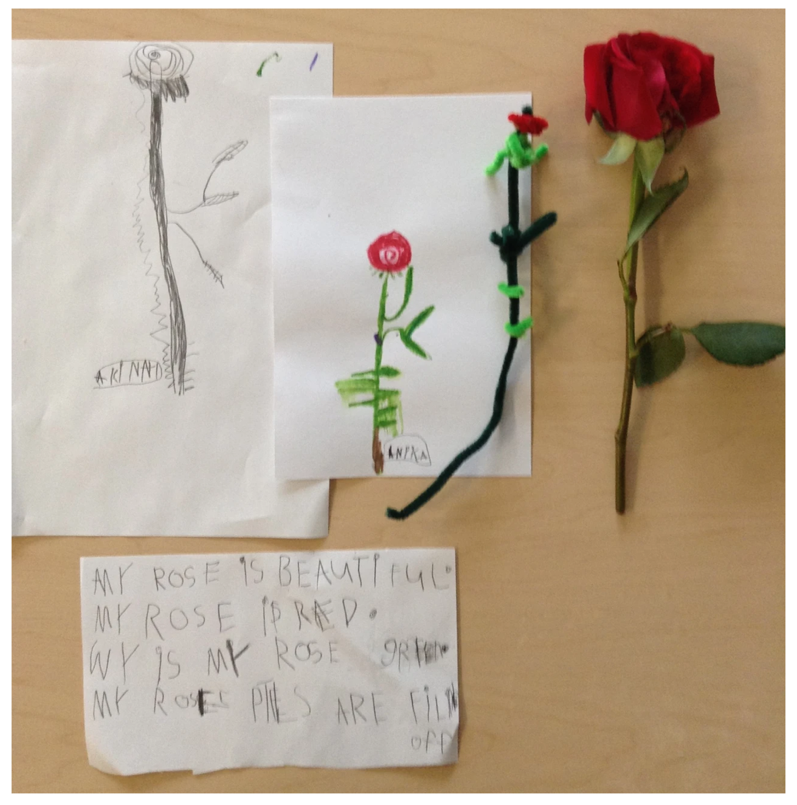
Children are natural artists.
They have a strong sense of wonder.
It fades as we get older.

Slide 6
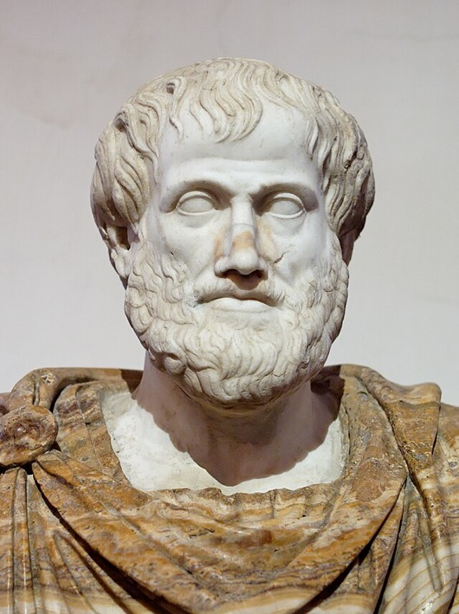
Sense of wonder
Aristotle: Philosophy begins in wonder.
In ancient Greece, philosophy encompass almost all disciplines.
Math starts with wonder.
Science starts with wonder.
Art starts with wonder.
莊子：「天地有大美而不言，四時有明法而不議，萬物有成理而不說。」

Slide 7
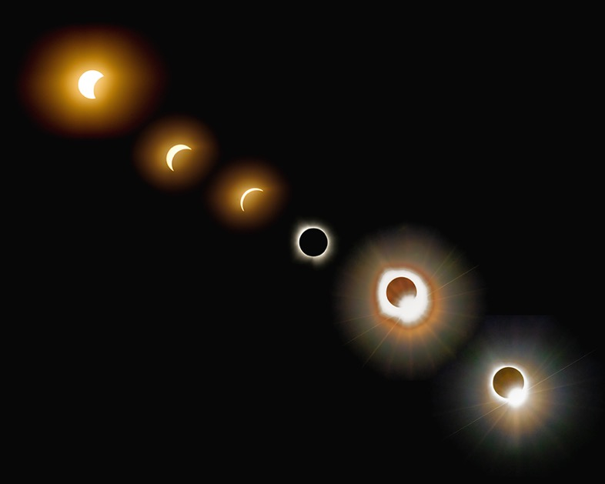
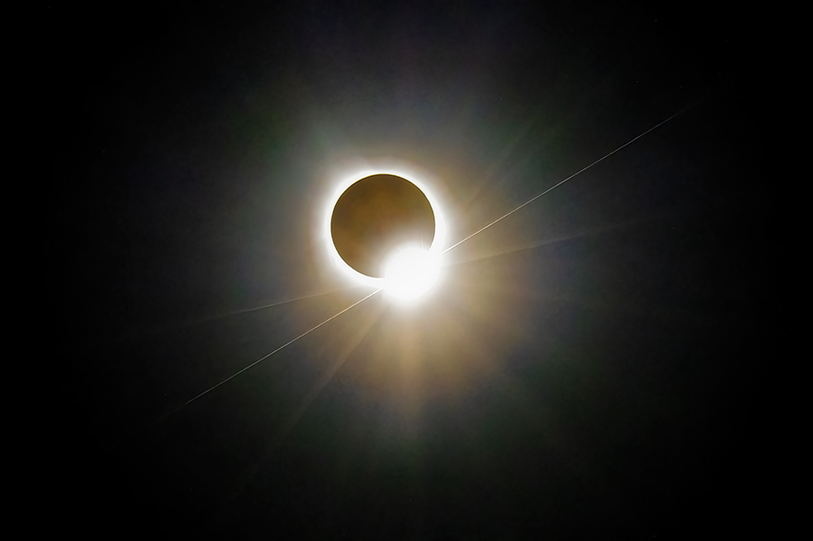
2024 Total Solar Eclipse
Art and astronomy are integrated.

Slide 8
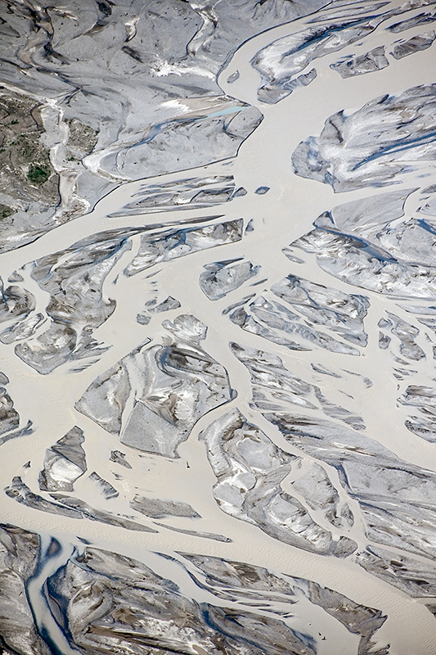

Glaciers
Art and geology are integrated.

Slide 9
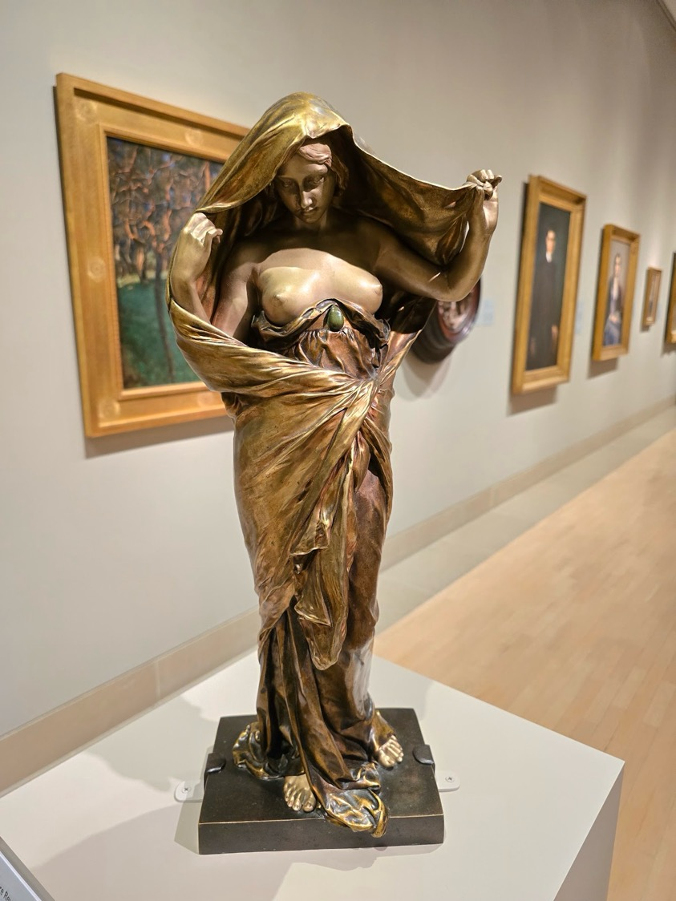
Nature reveals itself
Nature reveals itself to science
Louis Ernest Barrias (1905)
The beautiful female body is a symbol of natural wonder.
She exposes her face and body as a gesture of exploring Truth and science.
Art appreciation revives our sense of wonder to the world that is fading in our adulthood.

Slide 10
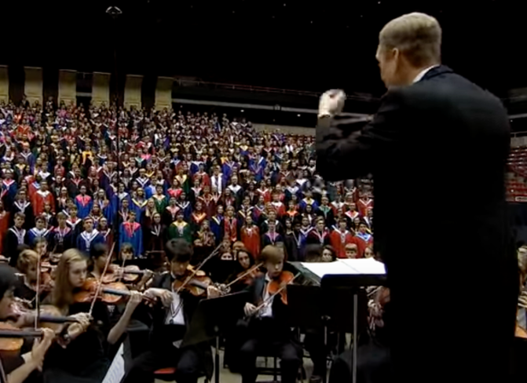
Haydn: The heavens are telling
The Heavens are telling the glory of God,
The wonder of his work displays the firmament.
Today that is coming speaks it the day,
The night that is gone to following night.
The Heavens are telling the glory of God,
The wonder of his work displays the firmament.
In all the lands resounds the word,
Never unperceived, ever understood.
The Heavens are telling the glory of God,
The wonder of his work displays the firmament.
YouTube

Slide 11

Organized chaos
We can see order out of randomness; we can get a sense of wonder from trivial matters or objects in every day's life.
Caddo Lake

Slide 12
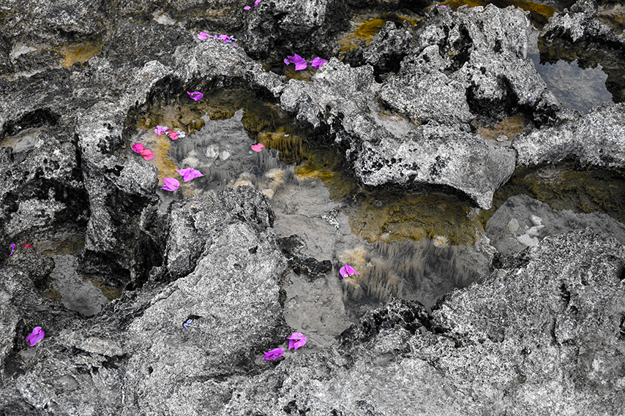
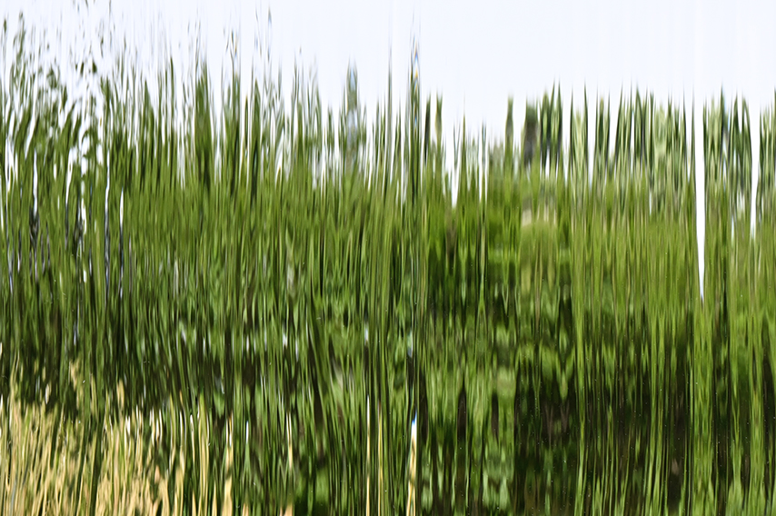
Organized chaos
In spite of seemingly chaos, there is a hidden order; there is a hope.

Slide 13
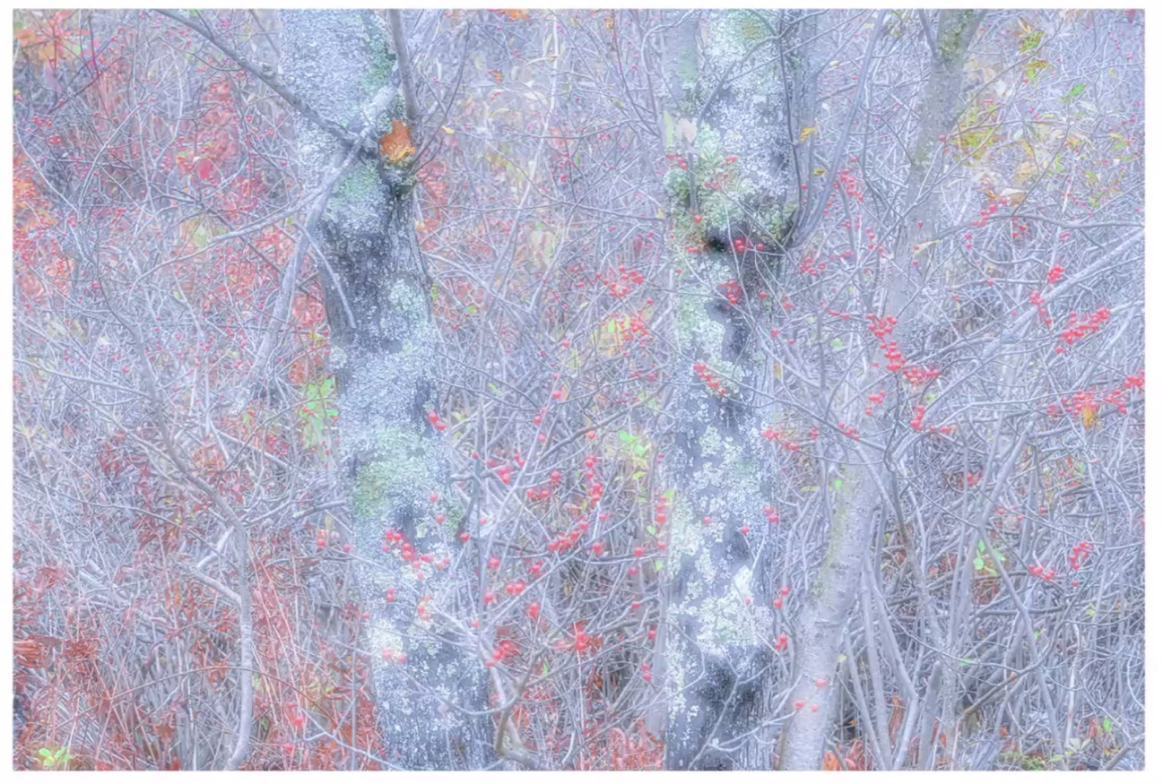
Organized chaos
Richard Martin
Contemporary American photographer

Slide 14
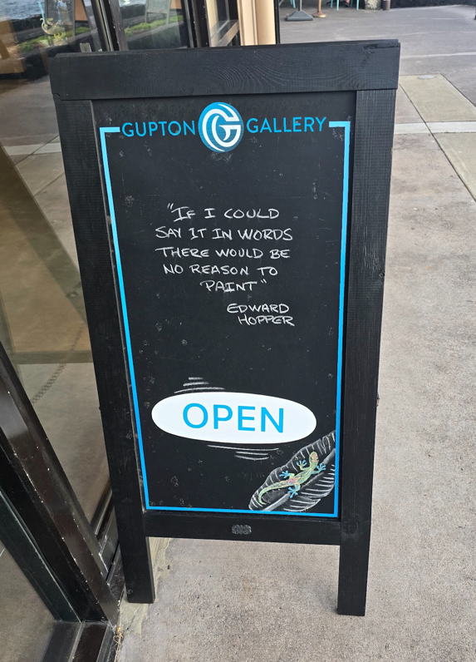
Symbolism and transcendent reality
Art often communicates through symbolism and metaphor. Biblical narratives are rich with symbols, parables, and allegories. Similarly, art can convey deeper spiritual truths beyond the literal.
Art often points beyond the material world. It invites us to consider transcendent realities—the eternal, the divine, and the mysterious.
Friedrich Schleiermacher (1768-1834): a sense and taste for the infinite.
只可以意會，不可以言傳。
千言萬語，盡在不言中。

Slide 15
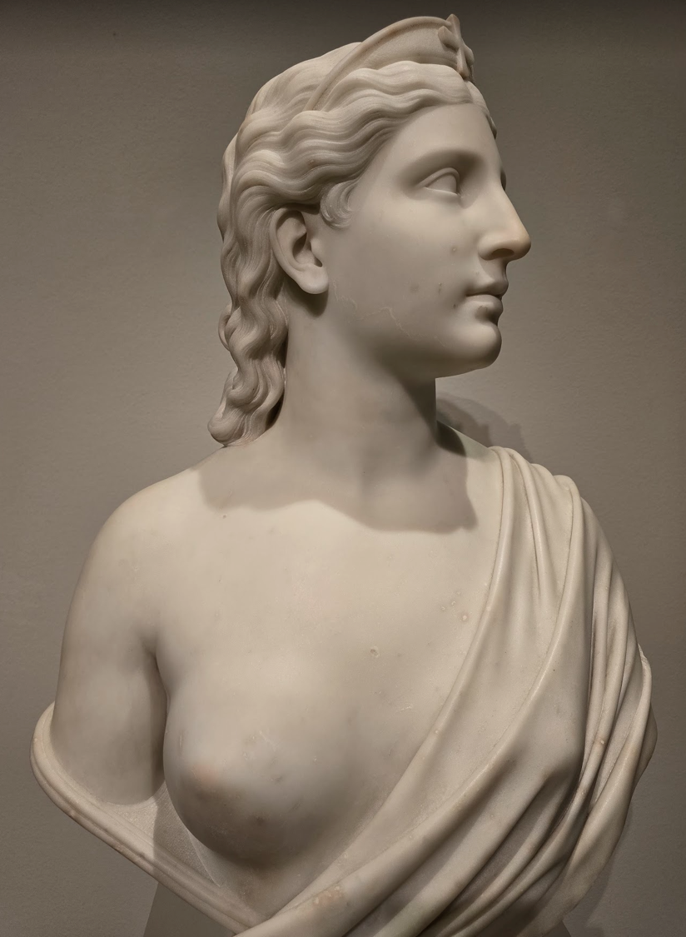
Faith
Hiram Powers (1873)
He made three busts to symbolize the Christian virtues of Faith, Hope, and Love.
Faith wears a tiara bearing the Greek cross on the head. And she looks up to Heaven.
Marble is a symbol of clarity, self-control and stability.
林子祥《石像》

Slide 16
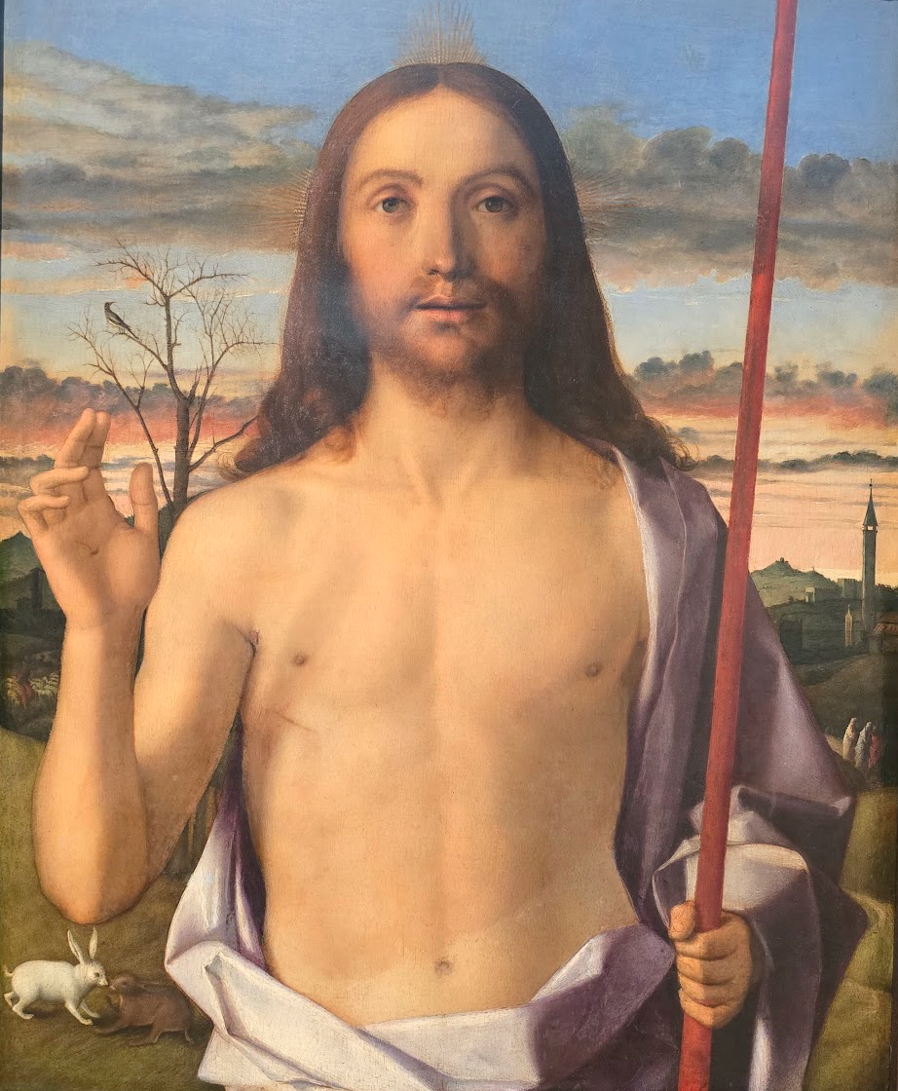
Christ Blessing
Giovanni Bellini (1500)
Christ: Fully human, fully divine
Golden rays from his head: Divinity
The withered tree with the solitary bird: The New Covenant grows out of the Old Covenant.
Rabbits: Resurrection
Staff: Good shepherd
Three robed persons: Witnesses
Bell tower: Salvation through the church
Dawn light: Victory over death and darkness.

Slide 17
Exploration of Biblical Themes
Many works of art and pieces of literature are inspired by biblical stories and themes. By engaging with these works or relating Biblical themes to current situations, we can gain new insights into familiar narratives and teachings, leading to a deeper understanding of their faith.
By exploring art, we learn to discern layers of meaning and connect them to our faith. For instance, a painting may depict the sacrifice of Christ, inviting us to reflect on redemption and grace.

Slide 18
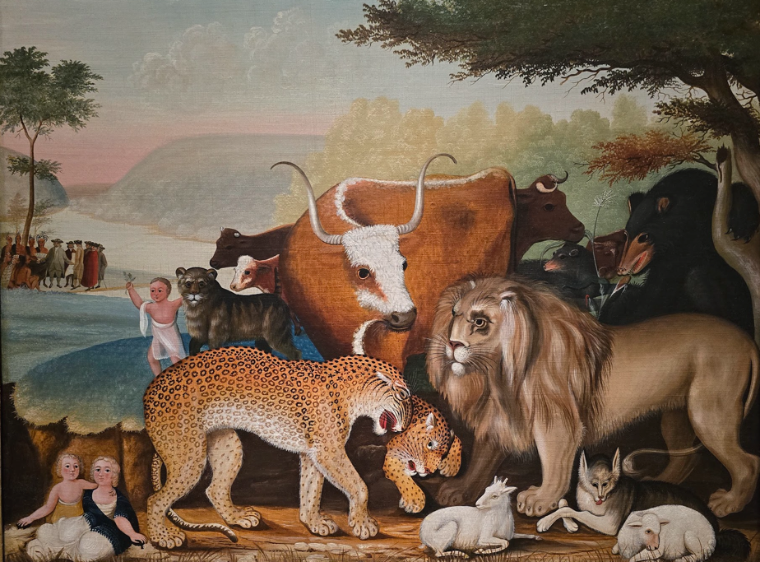
The peaceable kingdom
Edward Hicks (1846-1847)
Quaker: Pacifist
Isaiah
On the left-hand side, the painting portrays that William Penn signed a peace treaty with Native Americans living in the Delaware Valley.
A hope of peaceful coexistence.

Slide 19
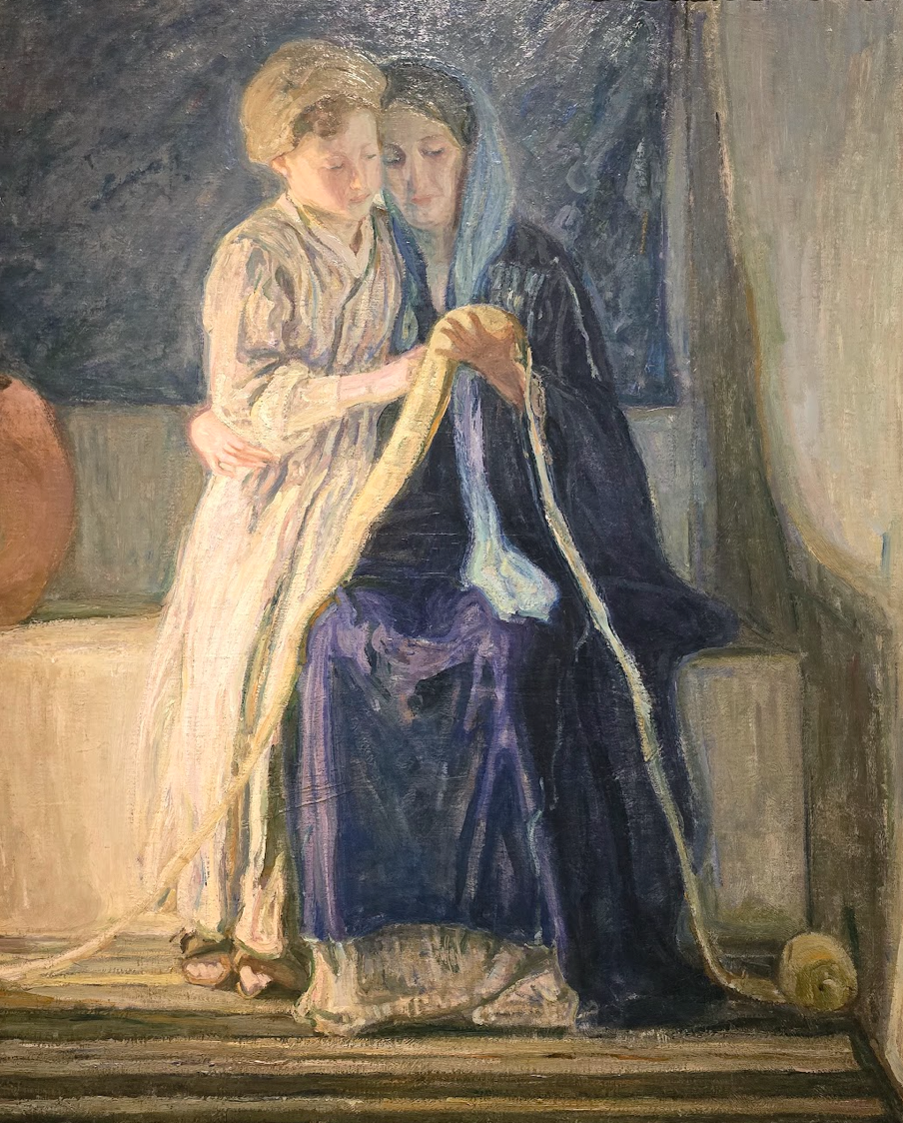
Christ and His mother studying the scriptures
Henry Ossawa Tanner (1908)
Unlike traditional religious paintings that portray Christ as a “superhuman”, Jesus in the painting looks like an ordinary child.
Jesus Christ is fully divine yet fully human.

Slide 20
Emotional and Reflective Engagement
Literature, poetry, and visual art evoke emotions and thoughts. They invite us to reflect on our own lives, struggles, and faith journey, thus cultivating our empathy and compassion.
When we read a profound novel or stand before a moving painting or sculpture, we engage in a spiritual dialogue. These moments of reflection can lead to prayer, meditation, and spiritual growth.

Slide 21
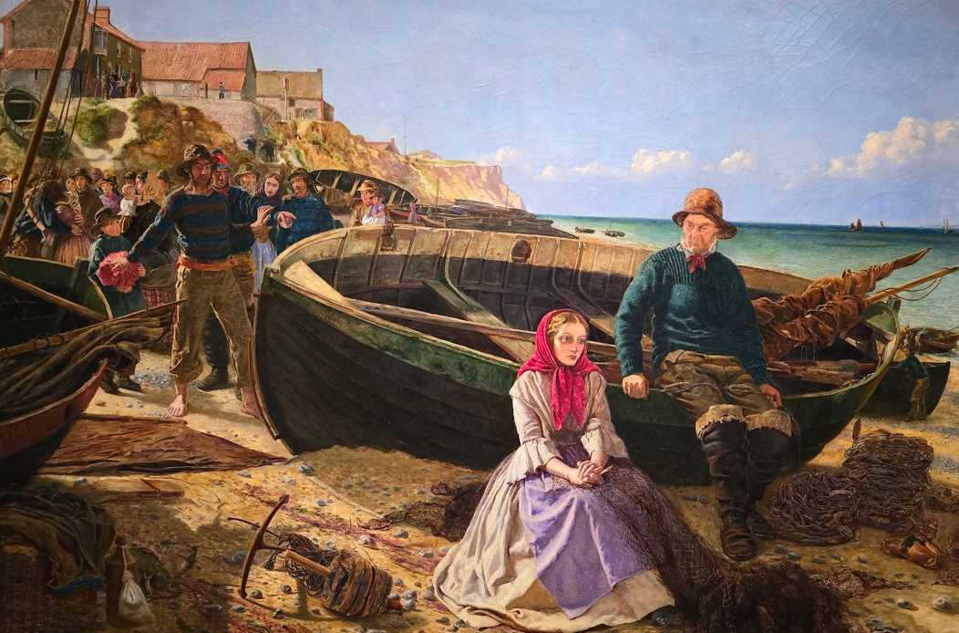
Return of the missing crew
Frederick Bacon Barwell (1860)
The young girl thought her lover is gone.
Reversal of fortune may be around the corner.
But, what if her lover was really dead?
What would I do if I were her?

Slide 22
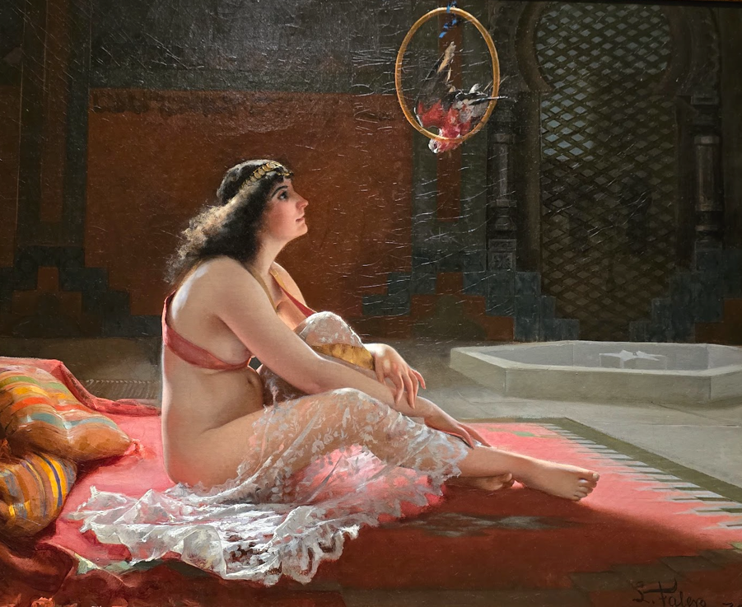
Woman in a Harem Courtyard
Luis Ricardo Falero (1875)
A concubine in a courtyard is looking at a bird.
Both are prisoners in spite of luxury.

Slide 23
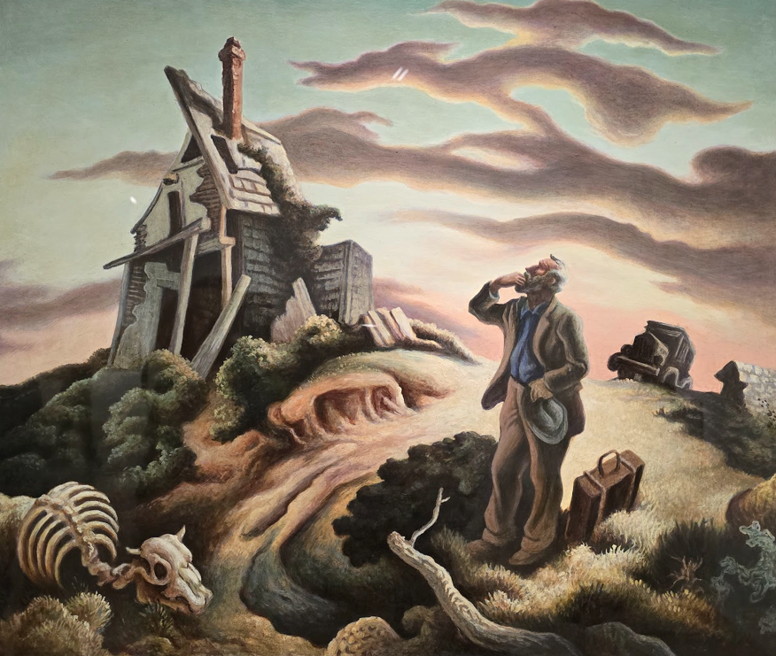
Prodigal Son
Thomas Hart Benton (1939-1941)
The NT story has a happy ending: the son is forgiven by the father when returning home (unlimited chances).
Alternate ending.
一失足成千古恨，回頭已是百年身。
桃花依舊，人面全非。

Slide 24
Inspiration for Worship and Creativity
Artistic expressions can serve as sources of inspiration for worship and creative expression within Christian communities. For example, architecture, hymns, visual arts, and performance.
Engaging with art and literature can stimulate one's own creativity and inspire new ways of expressing one's faith, whether through writing, visual arts, music, or other forms of artistic expression.
You may start to look at the world through a new perspective or a new lens, thus enriching your life.

Slide 25
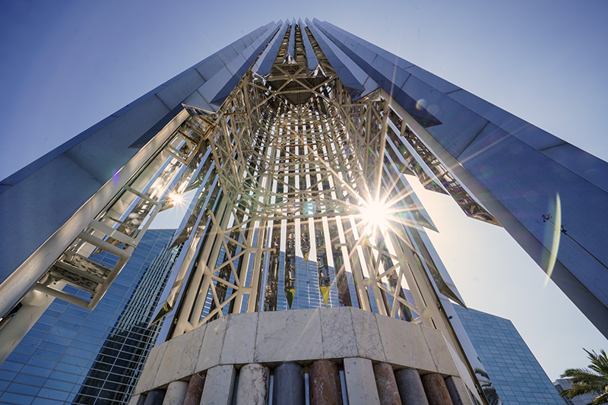
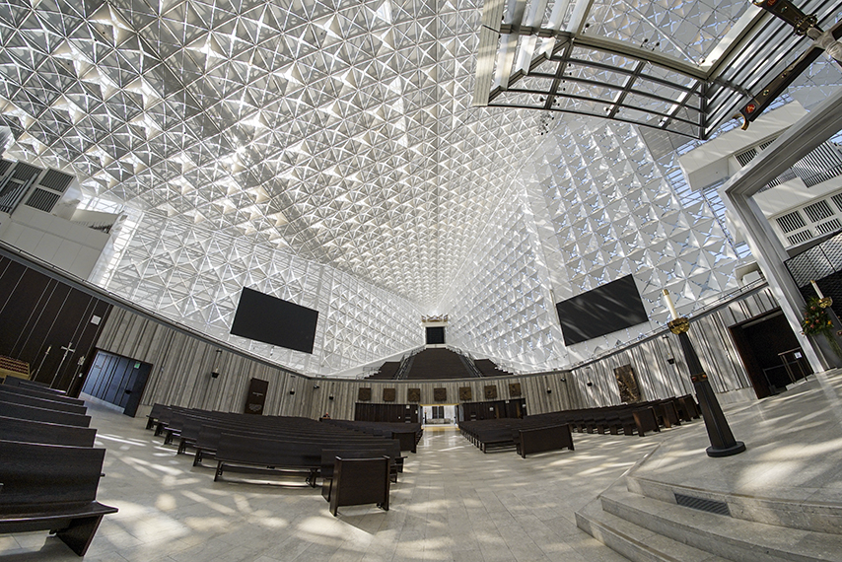
Christ Cathedral
Formerly Crystal Cathedral
Established in 1980 by Rev. Robert Schuller
Sold to the Catholic Church in 2011

Slide 26
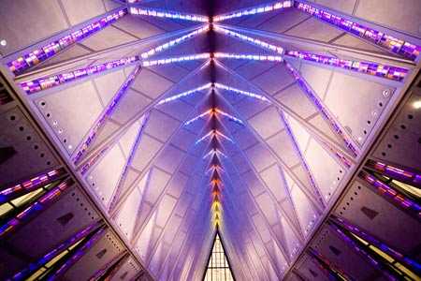
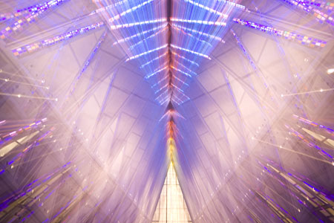
US Airforce academy chapel

Slide 27
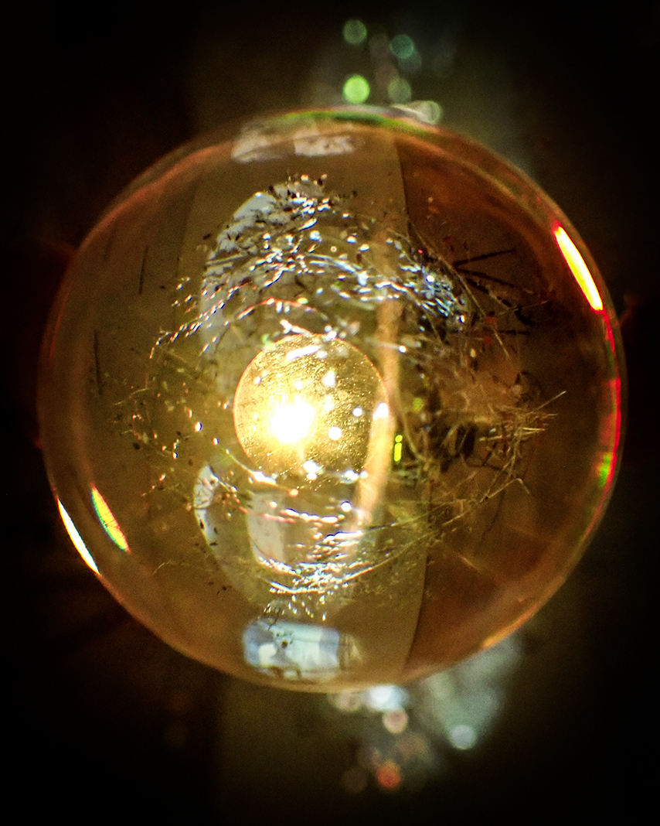

Boost Creativity

Slide 28
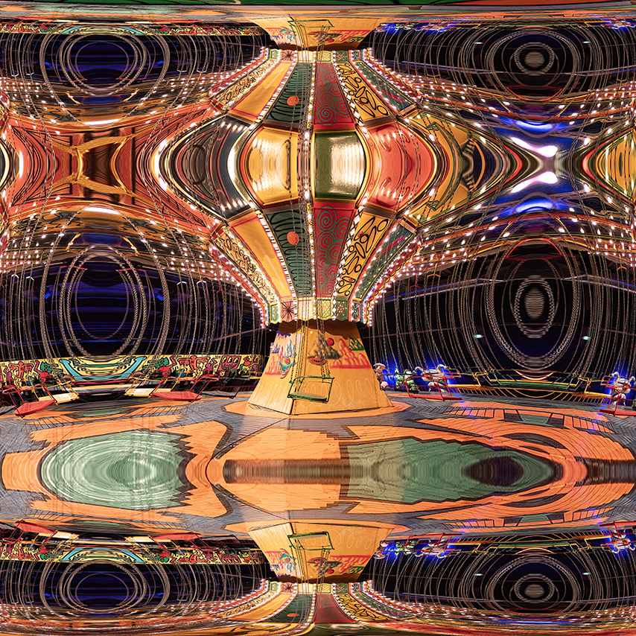
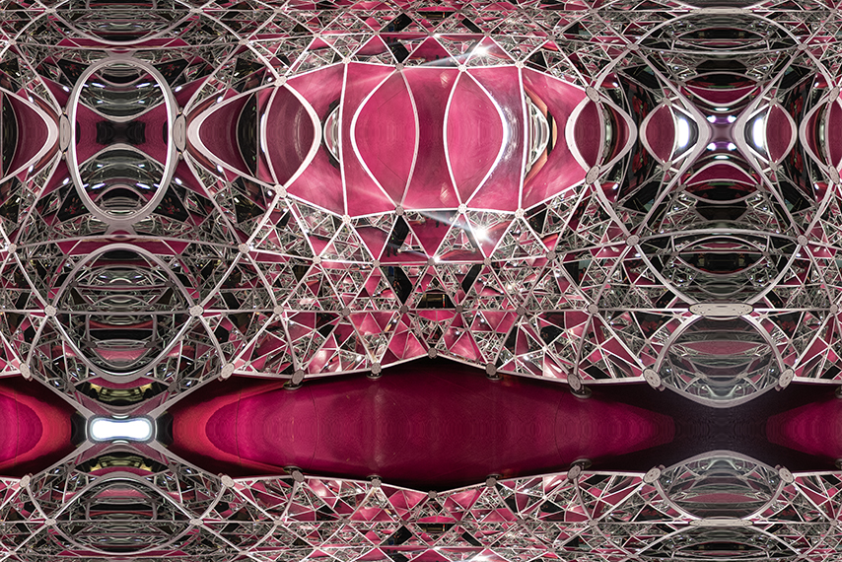
Boost Creativity

Slide 29
Summary
Restore the sense of wonder and appreciate the world
Reach the transcendental reality through symbolism
Explore Biblical themes and reflect upon them
Evoke emotion and stimulate thought, becoming more compassionate
Inspire creativity and see things through a new perspective

