Slide 1


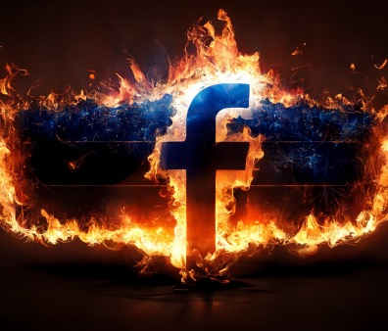
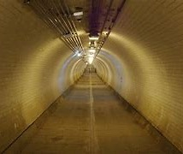
Misinformation and Disinformation during the 2024 Presidential Election
Living Grace Alliance Church’s Seminar
2024.10.31
Chong Ho Yu

Slide 2

1. Understanding Misinformation and Disinformation
Content
2. Examples of Misinformation/Disinformation in the 2024 Election
3. Psychological and Sociological Factors
4. Strategies to Combat Misinformation and Disinformation

Slide 3


Section 1
Understanding Misinformation and Disinformation

Slide 4
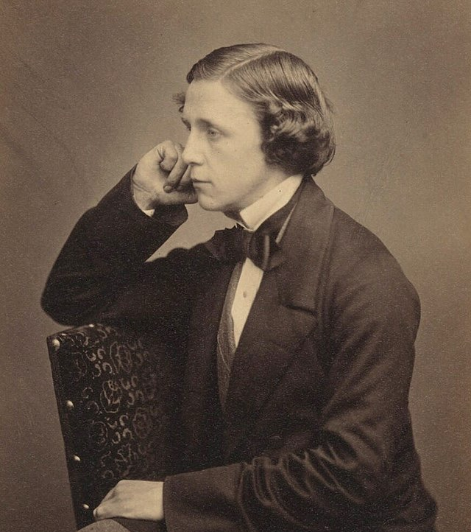
Lewis Carroll (from Alice in Wonderland)
"I am not crazy; my reality is just different from yours."

Slide 5
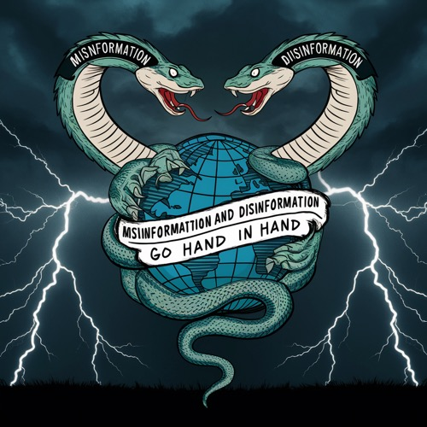
Historical roots
"Misinformation" has been in use since the late 16th century, but its usage has evolved over time.
The term "disinformation" originated in the 1920s, derived from the Russian word "dezinformatsiya".
These terms became more popular since the dawn of social media era.

Slide 6
Historical Context of Misinformation in Elections
Increased awareness of misinformation led to discussions on regulatory measures and the responsibilities of social media companies.
Post-election, investigations revealed foreign interference and the use of misinformation to sway public opinion.
The aftermath of the 2020 election prompted renewed focus on misinformation's role in undermining electoral integrity and public trust.
1
2
3
4
5
6
The 2016 U.S. Presidential Election saw significant misinformation spread via social media platforms, influencing voter perceptions.
The rise of fact-checking organizations aimed to combat misinformation, highlighting its growing impact on democracy.
The COVID-19 pandemic exacerbated misinformation, intertwining health-related falsehoods with electoral narratives during the election year.

Slide 7
Blurring Misinformation and Disinformation
Misinformation is spread without the intent to deceive while disinformation is spread with malicious intent.
Due to its intent, dissemination of disinformation is manipulation, not persuasion.
The two terms are sometimes used interchangeably, because it is difficult to determine the intent behind the spread of false information.
Typically, once misinformation is posted, individuals with malicious intent may seize the opportunity to amplify it, deliberately spreading the falsehood. In this way, misinformation evolves into disinformation.
Corner logo to be removed on all pages for video
Notes:
https://thecyberexpress.com/x-disinformation-network-linked-to-china/

Slide 8
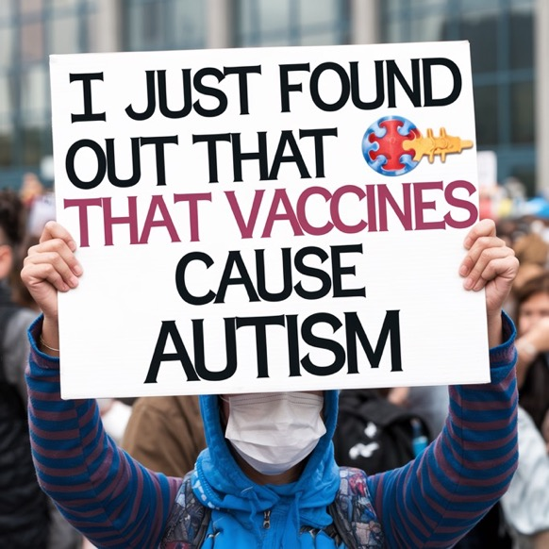
Definition of Misinformation
Misinformation refers to false or inaccurate information that is spread without the intent to deceive.
People sharing misinformation often believe the information to be true or are unaware of its inaccuracy.
The phenomenon of people sharing information without fact-checking is often referred to as "viral misinformation.” During a disease outbreak, it is known as "infodemic.”
Corner logo to be removed on all pages for video
Notes:
https://www.nytimes.com/live/2020/2020-election-misinformation-distortions
https://www.who.int/health-topics/infodemic#tab=tab_1

Slide 9
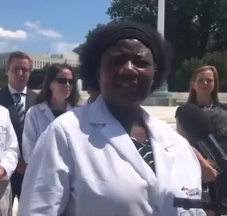
Example of Misinformation
Example: During the COVID19 pandemic, Dr. Stella Immanuel, claimed that hydroxychloroquine (a drug typically used to treat malaria) was a cure for COVID-19 even though empirical support was absent. Dr. Immanuel and her followers genuinely believed in the efficacy of the treatment. It appeared that there was no malicious intent behind it, and probably her intent was good.
Corner logo to be removed on all pages for video
Notes:
https://thecyberexpress.com/x-disinformation-network-linked-to-china/

Slide 10
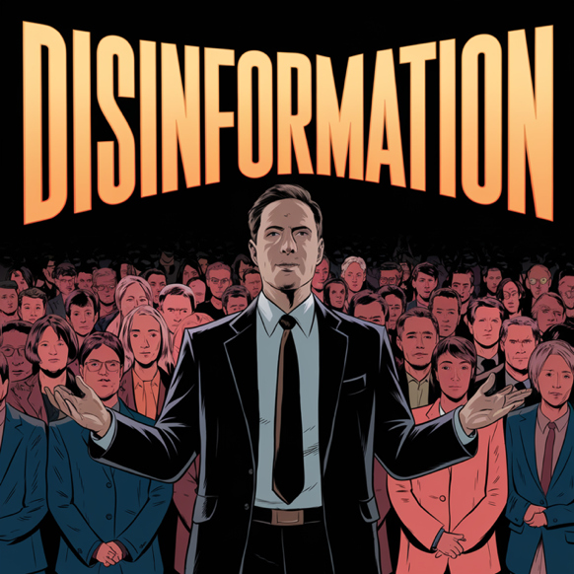
Definition of Disinformation
Disinformation involves the deliberate creation and dissemination of false information with the intent to mislead or manipulate others.
Disinformation is often used for strategic purposes, such as influencing public opinion, sowing discord, or achieving political or economic objectives.
Corner logo to be removed on all pages for video
Notes:
https://thecyberexpress.com/x-disinformation-network-linked-to-china/

Slide 11
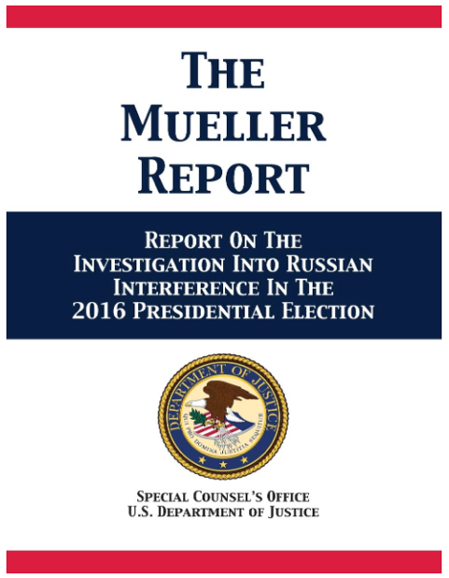
Russian Interference in 2016 U.S. Election
According to the Mueller Report, in 2016 the Internet Research Agency (IRA), a Russian troll farm, was accused of creating thousands of fake social media accounts to spread divisive content and disinformation.
These accounts used sophisticated targeting algorithms to reach specific demographics and amplify certain narratives, aiming to intensify polarities.
Corner logo to be removed on all pages for video
Notes:
https://www.amazon.com/Mueller-Report-Investigation-Interference-Presidential/dp/1680922629

Slide 12
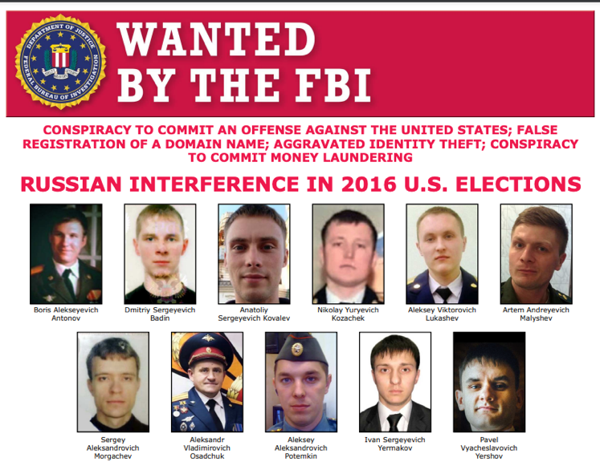
Russian Interference in 2016 U.S. Election
In 2018, the US government charged 12 Russian military intelligence officers for their alleged roles in interfering with the 2016 elections.
If you have any information about these people, please contact FBI or the US Consulate/Embassy. But please do not approach them on your own unless you know martial arts.
Corner logo to be removed on all pages for video
Notes:
https://thecyberexpress.com/x-disinformation-network-linked-to-china/
https://www.fbi.gov/wanted/cyber/russian-interference-in-2016-u-s-elections

Slide 13
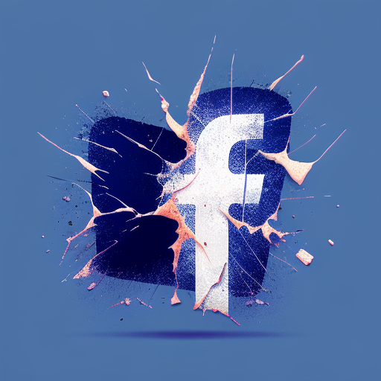
Overview of the 2024 Presidential Election Landscape
Impact of Misinformation
The 2024 Presidential Election landscape is significantly shaped by the pervasive spread of misinformation and disinformation, which poses challenges to informed voter decision-making and threatens the integrity of the electoral process, necessitating robust strategies for detection and mitigation.

Slide 14
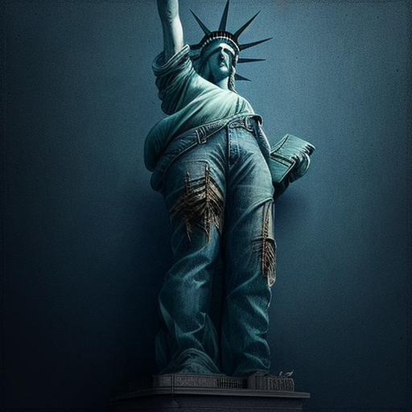
Importance of Addressing Misinformation
Preserving Democratic Integrity
Addressing misinformation is crucial for maintaining the integrity of the electoral process, as it ensures that voters have access to accurate information, thereby fostering informed decision-making and enhancing public trust in democratic institutions during the 2024 Presidential Election.

Slide 15
Section 2
Examples of Misinformation in the 2024 Election

Slide 16

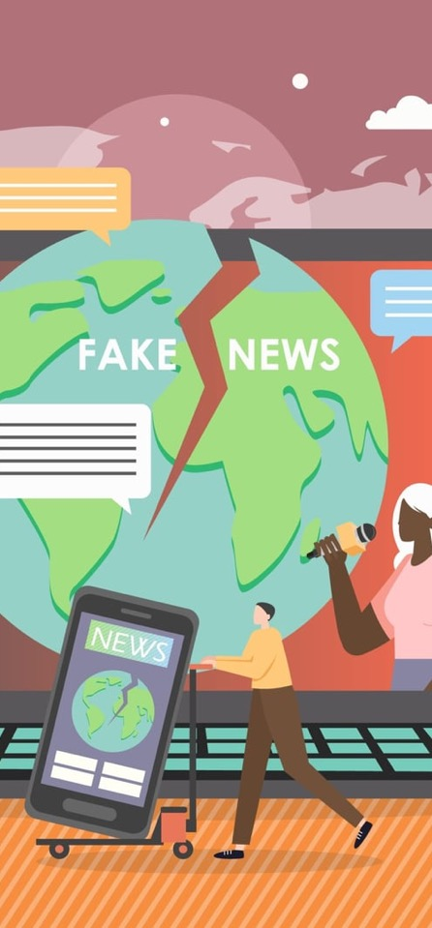
Misleading Statements about Candidates
Distortion of Candidate Positions
Misleading statements often misrepresent candidates' policies or positions, creating confusion among voters and potentially swaying public opinion based on inaccuracies rather than factual information.
Character Attacks and Fabrications
Candidates may face unfounded character attacks that distort their personal history or integrity, undermining their credibility and affecting voter perceptions without basis in truth.

Slide 17
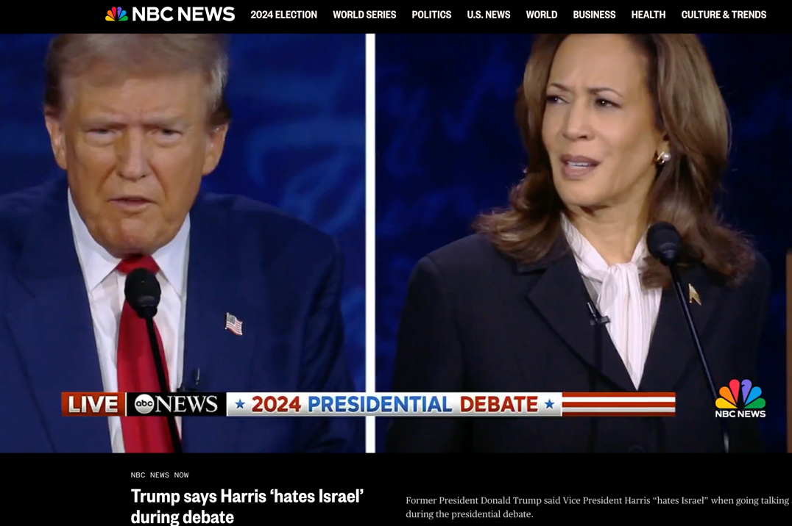
Accused Harris Hates Israel and being a communist

Slide 18
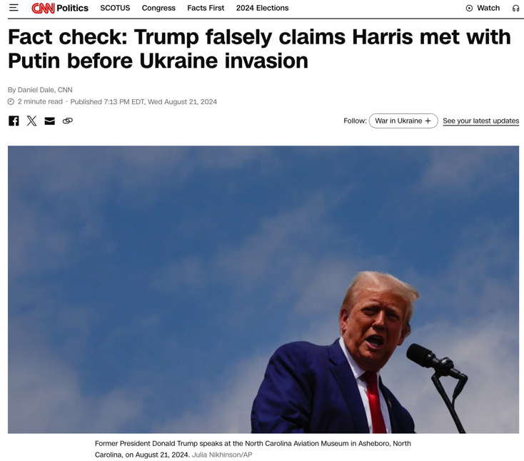
Ukraine
Trump said that Harris met with Putin just days before Russia invaded Ukraine in 2022.
Harris attended the Munich Security Conference.

Slide 19
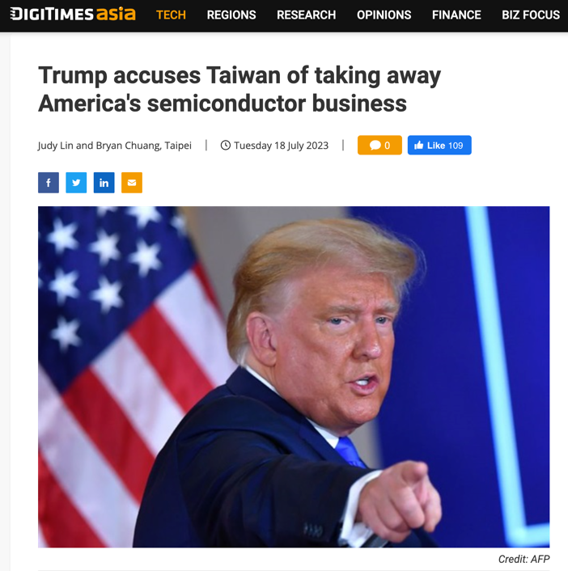
Taiwan
Taiwan accomplished the supremacy in semiconducting by innovation and hard work.

Slide 20
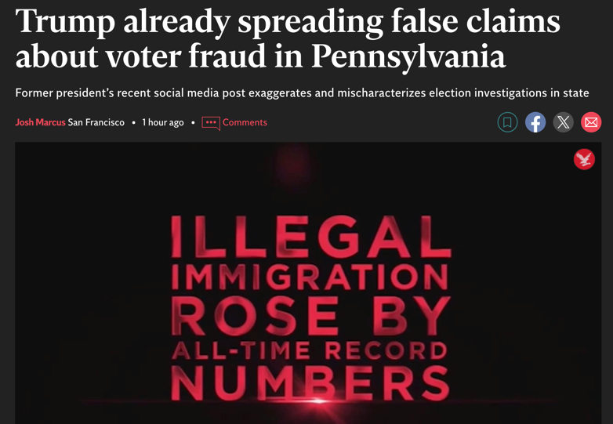
Voter Fraud
“Wow! York County, Pennsylvania, received THOUSANDS of potentially FRAUDULENT Voter Registration Forms and Mail-In Ballot Applications from a third party group. This is on top of Lancaster County being caught with 2600 Fake Ballots and Forms, all written by the same person. Really bad “stuff.” WHAT IS GOING ON IN PENNSYLVANIA??? Law Enforcement must do their job, immediately!!! WOW!!!”

Slide 21
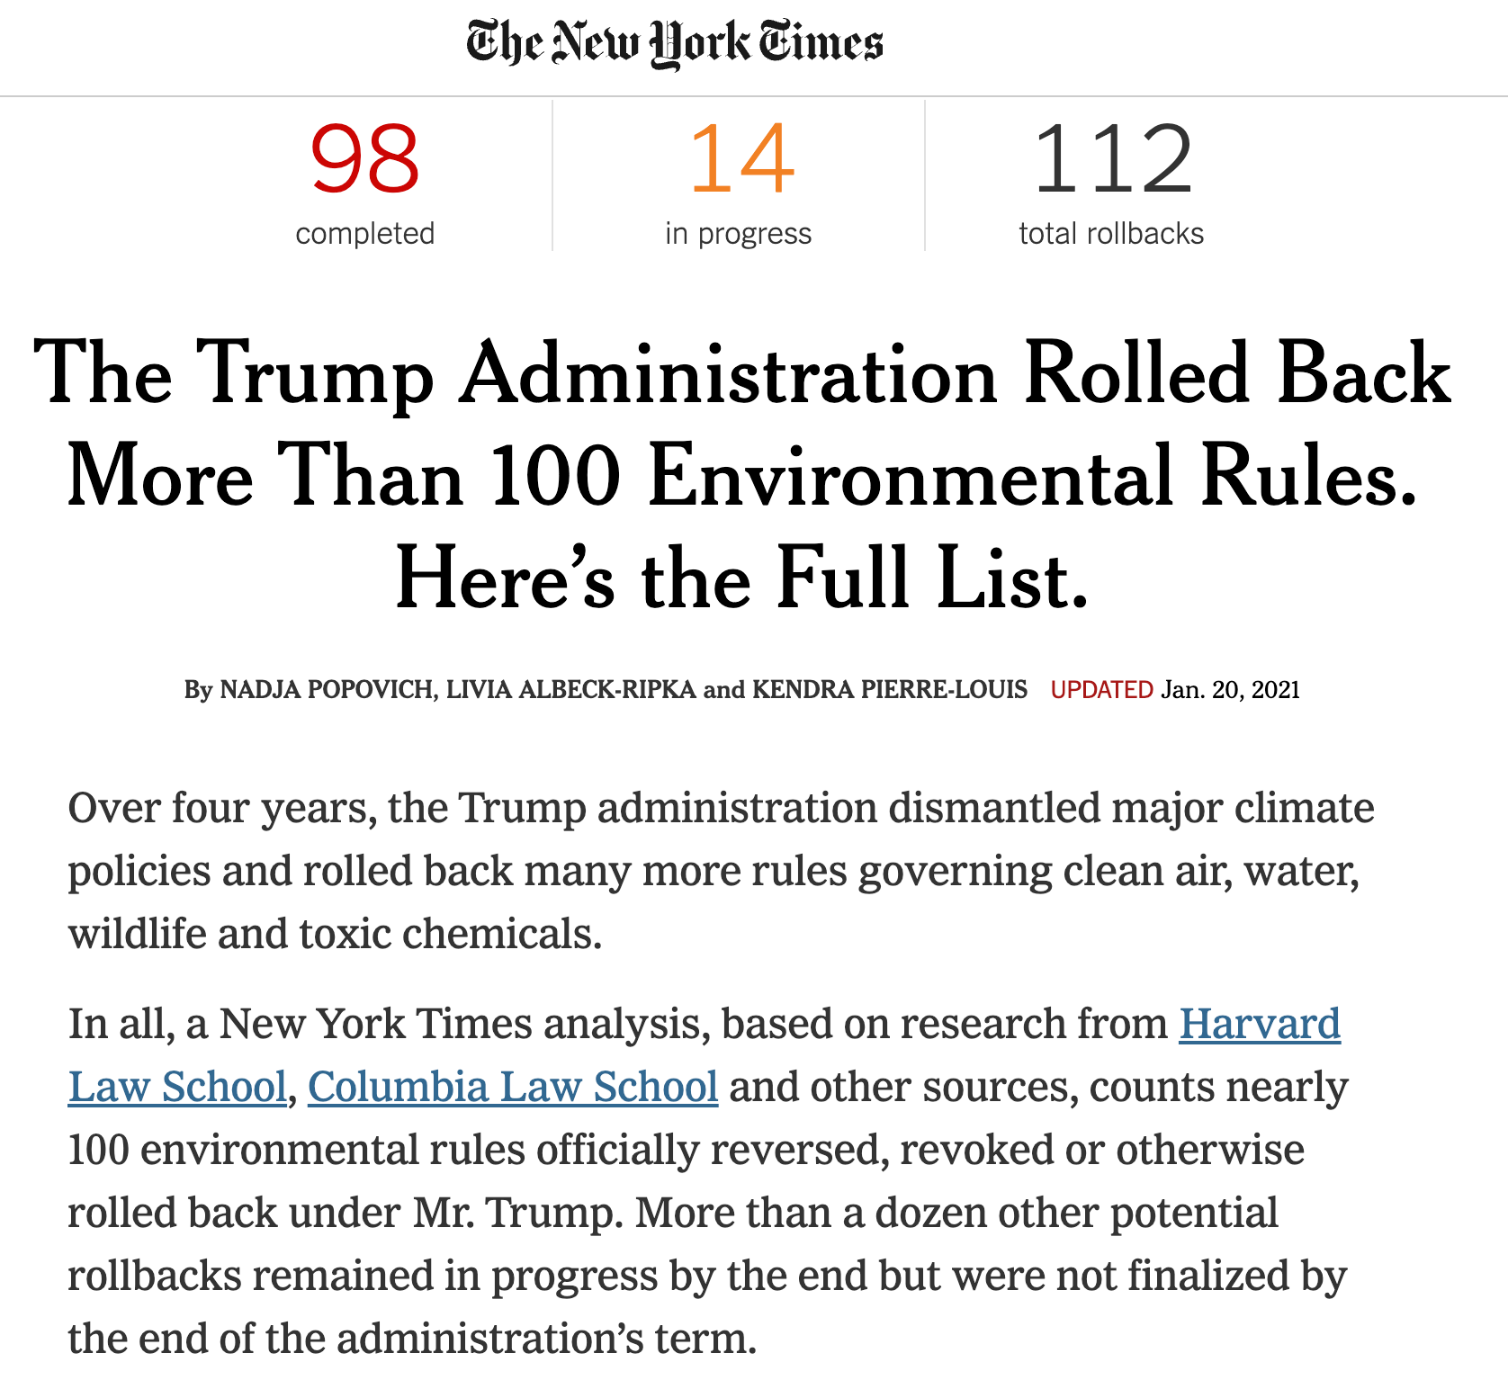
Environmental policy
During an interview with the podcast host Joe Rogan, Trump said “During our four years, we had the cleanest air and the cleanest water.”
Karoline Leavitt, a Trump campaign spokeswoman, said in a statement that, during his term, “President Trump advanced conservation and environmental stewardship while promoting economic growth for families across the country.”

Slide 22
Harris’s false claims
Harris claimed that Donald Trump’s agenda includes cutting Social Security and Medicare, citing "Project 2025" as evidence. While Project 2025 is a conservative plan endorsed by groups aligned with Trump's base, Trump himself has publicly disavowed this plan, specifically denying any intentions to cut Social Security and Medicare.
Harris tied Trump to Project 2025 due to the involvement of former Trump officials, but the plan does not explicitly include cuts to these programs, nor has Trump indicated he would implement it as a policy platform if re-elected.

Slide 23
Harris’s false claims
Harris repeated a popular talking point about Trump wanting to be a "dictator on Day 1" if re-elected, based on his comment that he would "use power for retribution on Day 1."
This remark, made during a Fox News interview, was in response to a question about potential abuse of power. However, the context provided was that Trump would focus on measures like tightening the border rather than dictatorship per se. Harris’s interpretation was thus a point of contention, as it did not align fully with Trump's own clarification

Slide 24
Section 3
Psychological and Sociological Factors
Notes:
https://cyabra.com/blog/psychological-effect-of-disinformation/

Slide 25
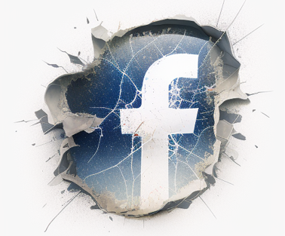

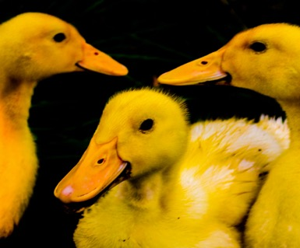
Psychological and sociological factors
Confirmation Bias
Echo chamber/Filter bubble
Anchoring Effect/Baby Duck Syndrome
Voters often seek information that confirms their pre-existing beliefs, leading to selective exposure to misinformation during the 2024 Presidential Election, which can distort their understanding of candidates and issues.
Voters are trapped in an environment, such as social media, that feed them with what they like to hear, thus reinforcing preexisting bias. This creates neotribalism.
Initial information encountered about candidates or policies can disproportionately influence voter perceptions, making them susceptible to misinformation that aligns with those first impressions.

Slide 26
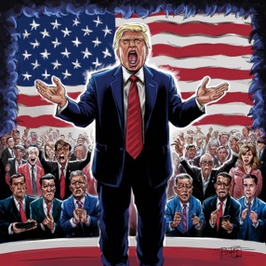
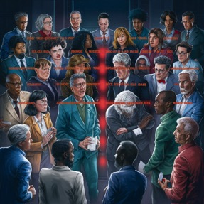
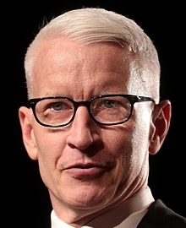
Psychological and sociological factors
Role of Emotions
Trust
Emotional responses, such as fear, anger, and patriotism, can significantly enhance the acceptance of misinformation, as emotionally charged narratives are more likely to resonate with individuals. In some cases, scapegoating out of fear become a convenient excuse.
Social Identity Theory
Trust in sources of information plays a critical role in belief formation; individuals are more likely to accept misinformation from trusted figures or platforms. Once CNN commentator Anderson Copper said that many people are anti-science, anti-authority, and anti-intellectual.
Social identity theory suggests that group membership influences individuals' responses to misinformation; during the 2024 Presidential Election, this can lead to heightened defensiveness against opposing viewpoints.

Slide 27

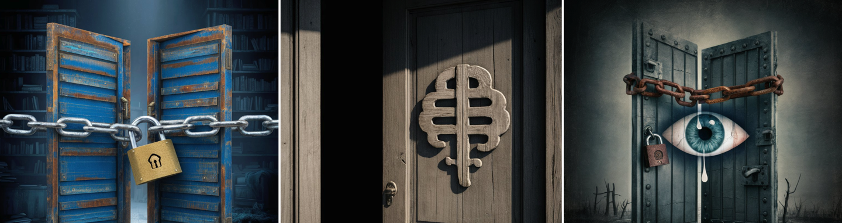
Dunning–Kruger effect
Epistemic closure
Availability Heuristic
Dunning–Kruger effect describes the psychological phenomenon that Individuals’ inflated ego leads them to overestimate their knowledge level, thus resulting in embracing misinformation and disinformation.
It is the tendency to believe that one’s knowledge or worldview is complete and definitive, leading to a sense of certainty about "absolute truth" that resists new information, alternative perspectives, or open dialogue. Both leftists and Christians have this problem.
This cognitive shortcut leads people to rely on immediate examples that come to mind. When misinformation is readily available (for instance, on social media), it feels more plausible simply because it’s more accessible, leading people to judge it as more likely.

Slide 28
Section 4
Strategies to Combat Misinformation and Disinformation

Slide 29
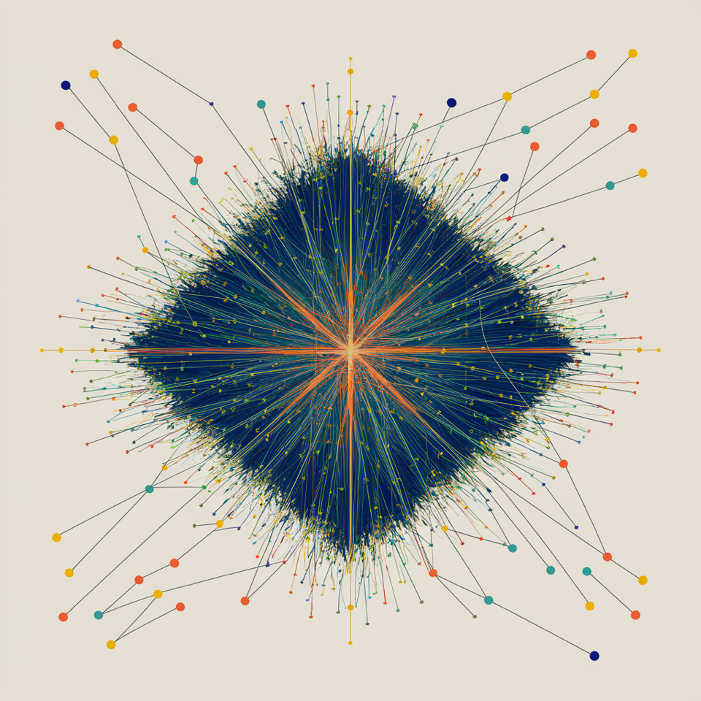
What can we do?
Develop critical thinking, such as counterfactual reasoning
Counterfactual thinking is to think the otherwise. For instance, given the same situation, if the label or the identity is changed, will I draw the same conclusion (e.g. disinviting Ann Coutler).

Slide 30

What can we do?
Admit cognitive bias
Admit our intellectual and cognitive limitations, watch out the cognitive bias and logical fallacies discussed earlier. Accept uncertainty and the inconclusive nature on certain issues. You always have a choice!
Pause and Fact-Checking
When in doubt, leave it out. Do not accept and forward incoming information just because it fits my view. The development of fact-checking tools leverages artificial intelligence can quickly analyze claims made during the 2024 Presidential Election, helping to combat the rapid spread of misinformation across various platforms.

Slide 31


Contact:
Chonghoyu@gmail.com

