Slide 1
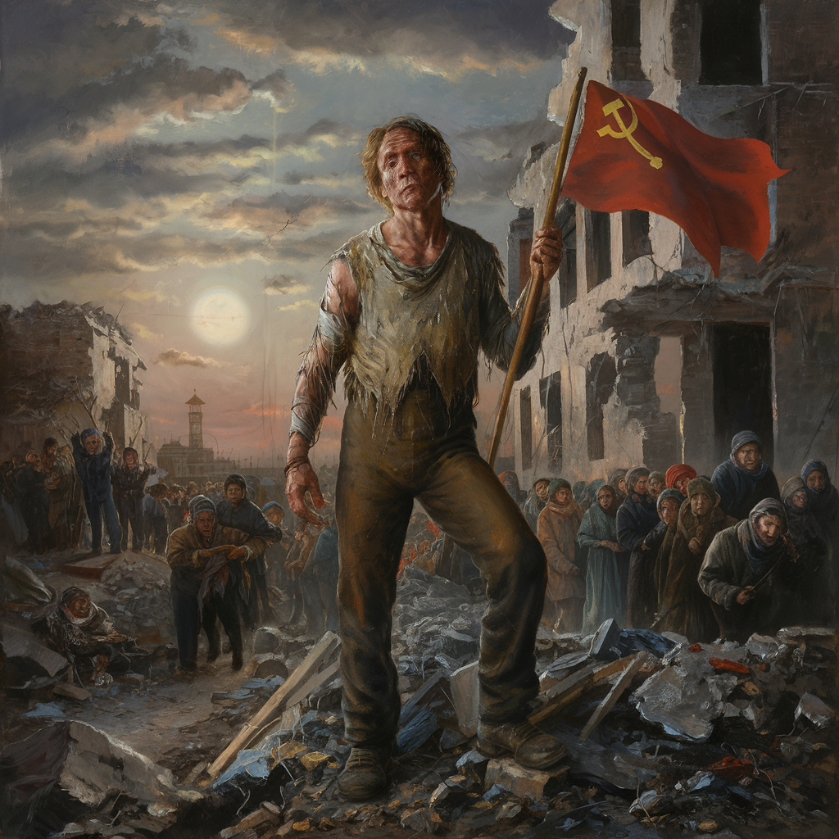
Soviet Disunion: The fall of evil empire
Chong Ho Yu

Slide 2
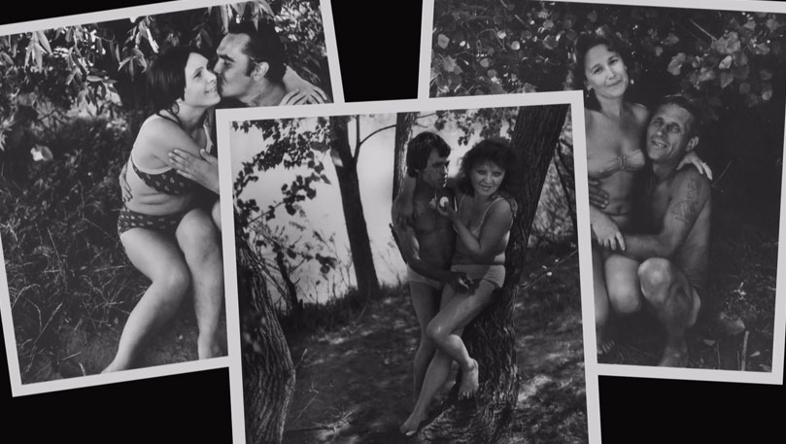
Vladimir Lenin (1917-1924)
World revolution: International Communist Movement
1917: removed religious instruction from school curricula
1918: deprived the formerly official church of its status of legal person
“Communism, common wife”
Sexual revolution: More liberal than the West
Syphilis spread throughout the country.
1922: estimated nine million abandoned children

Slide 3
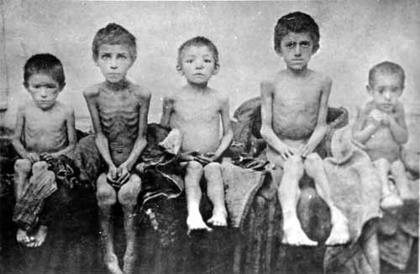
Joseph Stalin (1922-1953)
Collectivization
The Ukrainian Man-Made Famine of 1932-33 (Holodomor):
Heavy industry
Writers or intellectuals are oppressed
Massive surge in officially promoted nationalism and xenophobia, everything foreign was condemned and everything Russian was praised.

Slide 4
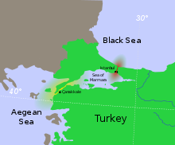
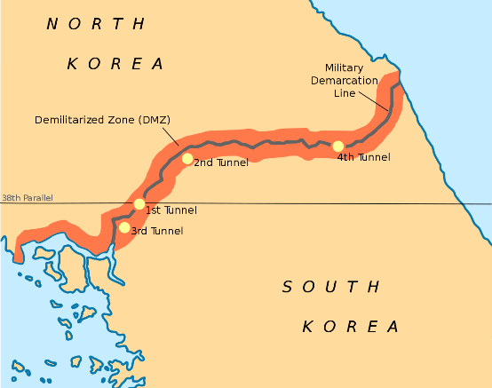
Joseph Stalin (1922-1953)
Cold War
1945 Turkey was pressured by the Soviet government to allow Russian shipping to go through the Turkish Straits
1947 Truman Doctrine
1948 Berlin Airlift
1949 PRC established
1950 Korean War

Slide 5
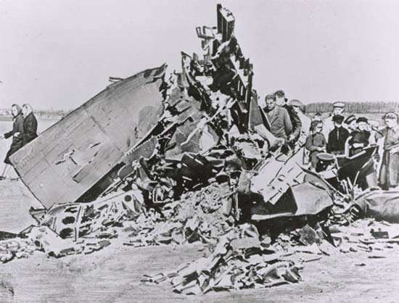
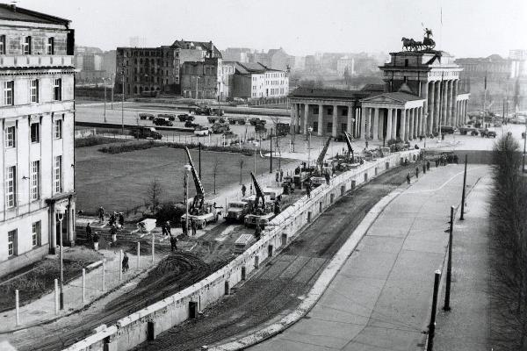
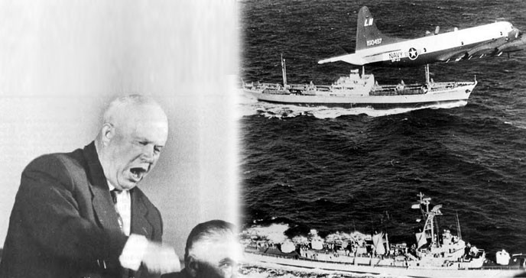
Nikita Khrushchev
(1953-1964)
de-Stalinization
Stimulate the consumer economy
1960 U-2 incident
1961 construction of Berlin wall
1962 Cuban missile crisis

Slide 6
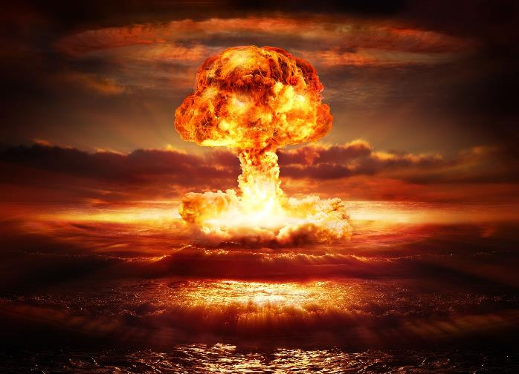
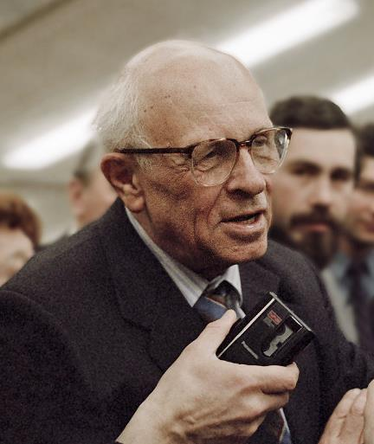
Dissident: Andrei Sakharov
1953: Father of USSR’s hydrogen bomb
From late 1950s he became activist in civil liberty and international peace, and faced persecution
Won the Nobel Peace Prize in 1975.
The Sakharov Prize by the European Parliament.

Slide 7
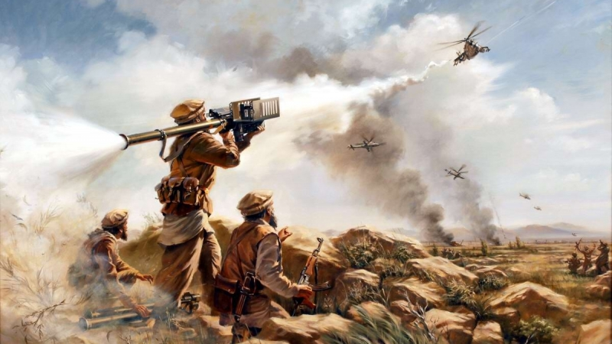
Leonid Brezhnev (1964-1982)
1975 “liberated” South Vietnam
1979 invaded Afghanistan
Charlie Wilson's War
“Trust in cadres”: a privileged class
Give economic interests to people e.g. free health care, subsidized housing, state pension…etc.
Developed socialism: welfare state
“They pretend to pay us and we pretend to work”

Slide 8
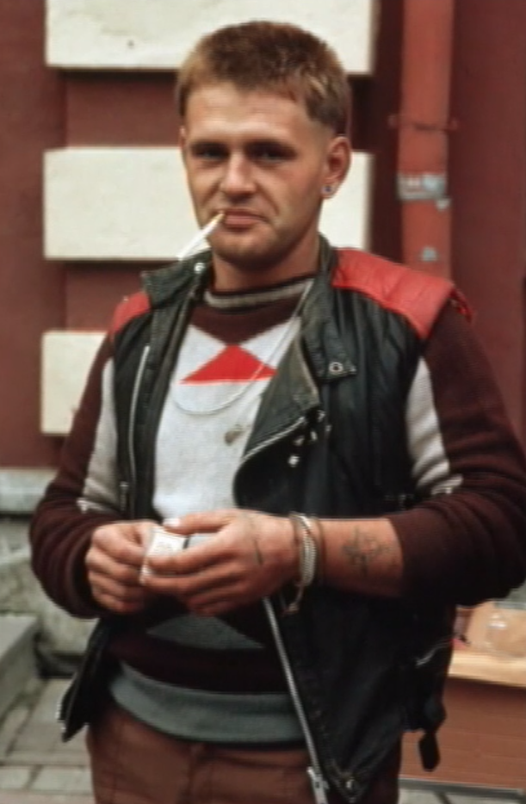
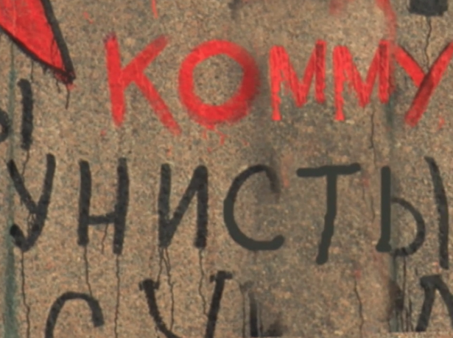
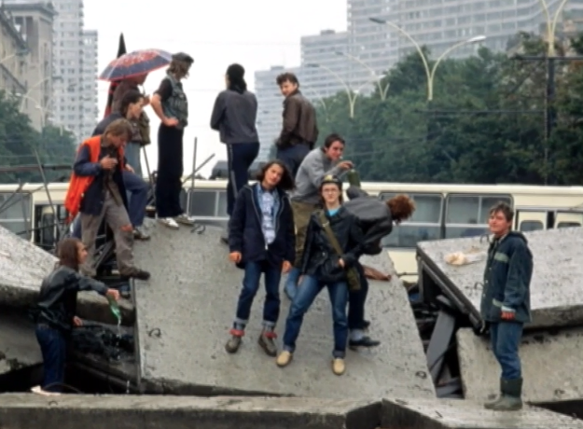
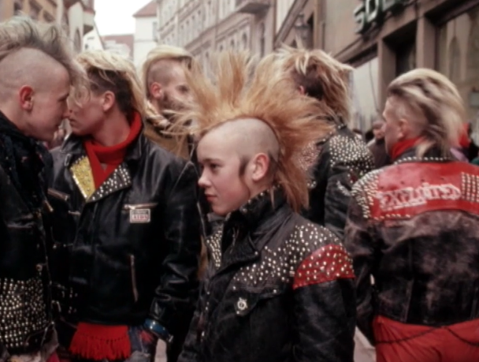
Leonid Brezhnev (1964-1982)
Passive resistance by adopting Western styles

Slide 9
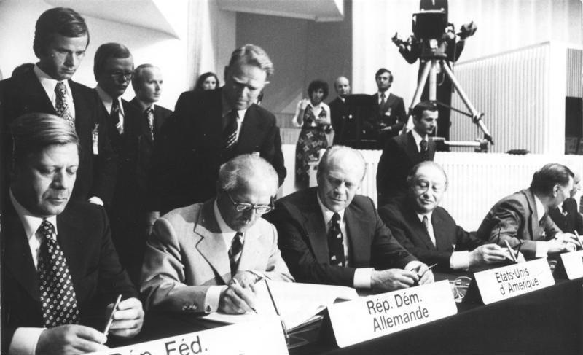
Helsinki accord and Helsinki Groups
1975 Helsinki Accords: 35 countries, including the US, Canada, and all European countries except Albania and Andorra signed the declaration. The West recognizes Soviet dominion of East Europe, but USSR should respect their human rights
Moscow Helsinki Group (1976–present)
Ukrainian Helsinki Group (1976–81)
Lithuanian Helsinki Group (1976–82)
Georgian Helsinki Union (1976–93)

Slide 10
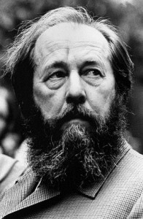
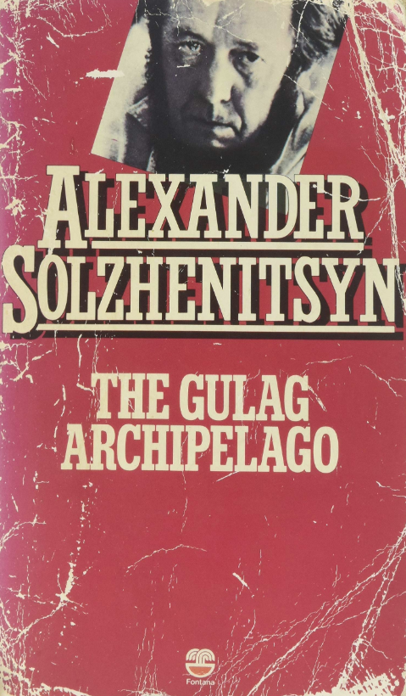
Dissident: Alexander Solzhenitsyn
1945: he was arrested and imprisoned after he wrote negative comments in a private letter
His books were banned: Cancer Ward (1968), August 1914 (1971), and The Gulag Archipelago (1973)
1974: he was arrested and deported from USSR to Frankfurt, and stripped of his Soviet citizenship.
Moved to Stanford, USA later
Head of KGB Yuri Andropov tried to discredit Solzhenitsyn
1994: Returned to Russia
https://www.youtube.com/watch?v=t--pNU9ZfVE

Slide 11
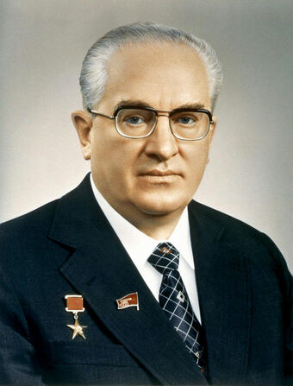
Yuri Andropov (1982–1984)
The Soviet ambassador to Hungary from 1954 to 1957, involved in the suppression of the 1956 Hungarian Uprising.
Chairman of the KGB in 1967: Mass arrests and sent "socially undesirable“ to psychiatric treatment.
During the Prague Spring in 1968, Andropov was the main advocate for "extreme measures"

Slide 12
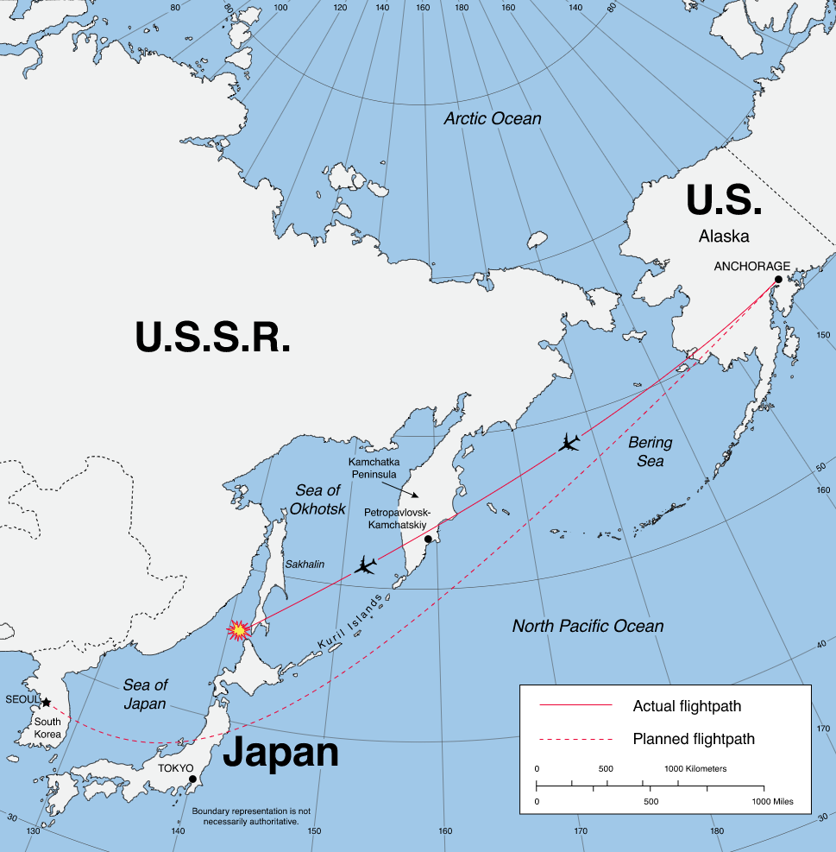
Yuri Andropov (1982–1984)
September 1, 1983: Korean Airline 007 was shot down by Soviet missiles.
USSR accused US of using the airliner for spying.
The black box was found on Sept. 15, 1983 but the information was released in 1993: 1. No evidence that KAL 007 is a spy plane 2. no evidence that the Soviet interceptor attempted to contact KAL007 or give a warning shot.

Slide 13
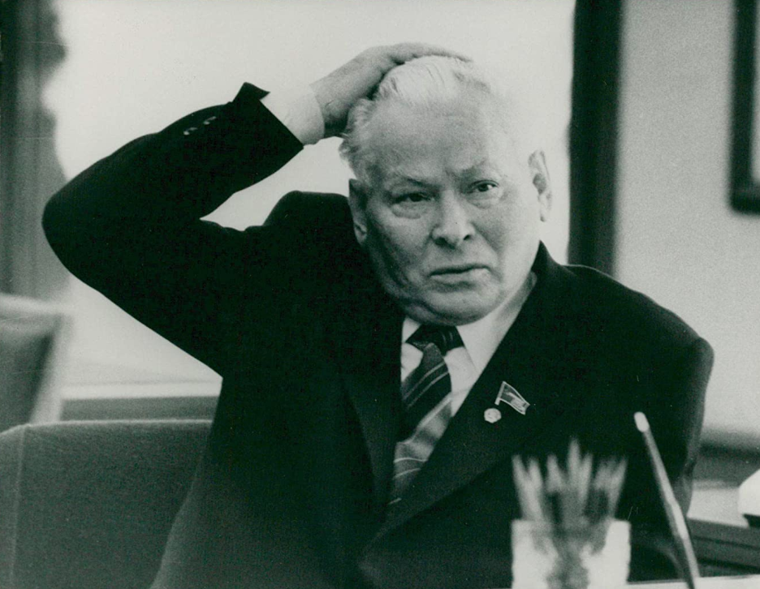
Konstantin Chernenko
Lasted one month (Feb 13, 1984–March 10, 1985)
USSR decided to find a younger and healthier leader.
Relationship with USA deteriorated.
More educated society
Exposure to new ideas from the West

Slide 14
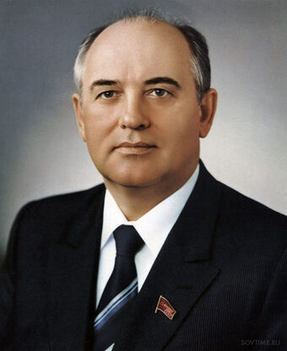
Mikhail Gorbachev
Tried to improve the relationship with the US
True believer of Communism
Admit that the practices of Soviet socialism were far from democratic.
Political and economic restructuring (perestroika)
openness in civic discussions of both the past and the present (glasnost’)

Slide 15
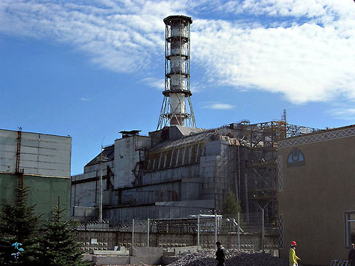
Mikhail Gorbachev
1986 April 26 Chernobyl disaster
Very close to May 1 Labor Day
Evacuation after 36 hours
Gorbachev announced it after 18 days
“9 people died”
“The worst is behind us”
https://www.youtube.com/watch?v=0k3wnXBE5S0

Slide 16
Mikhail Gorbachev
Real democracy: orderly and responsible public participation.
Real freedom in “civic responsibility” and “law and order” (Pravoporiadok).
Criticize the problem of leadership quality: Formalism, procrastination…etc.
Promote a high moral code
Reform failed

Slide 17
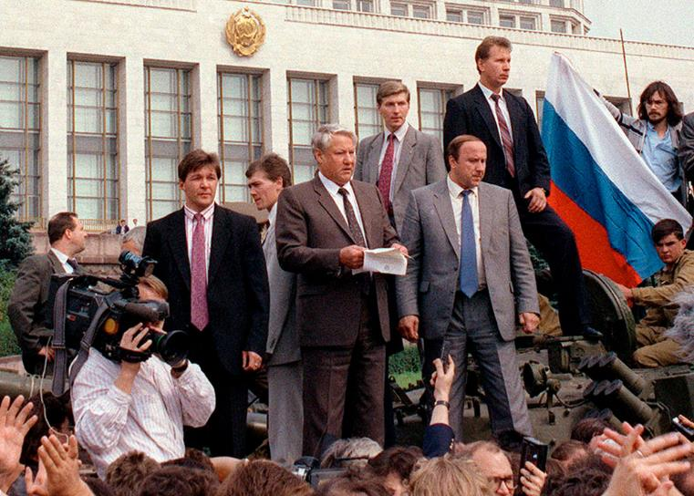
Mikhail Gorbachev
Hardline Communists viewed his ideas as radical.
Liberal-minded citizens disliked his continual commitment to Communism and insisted on greater change.
1989 the Fall of Berlin Wall and revolutions in East Europe
In 1990–1991, the Baltic States and Georgia demanded independence
1991 August 21: Coup
Boris Yeltsin was elected President of the Russian Republic and USSR dissolved

Slide 18
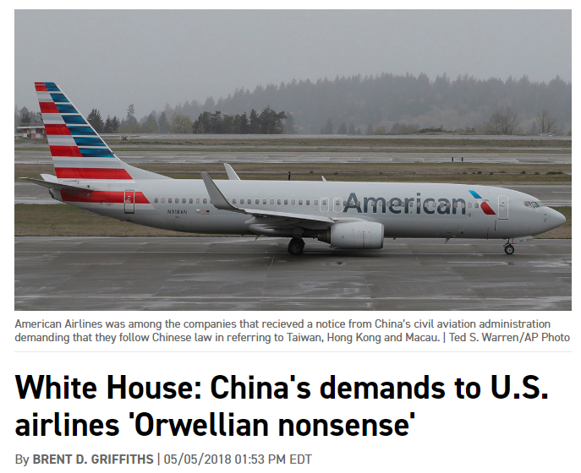
Orwellian nonsense?
In May 2018 China told several US airliners to add “China” into the name of Taiwan, Hong Kong and Macau, or face consequences.
Trump accused China of “Orwellian nonsense.”
What is “Orwellian nonsense?”

Slide 19
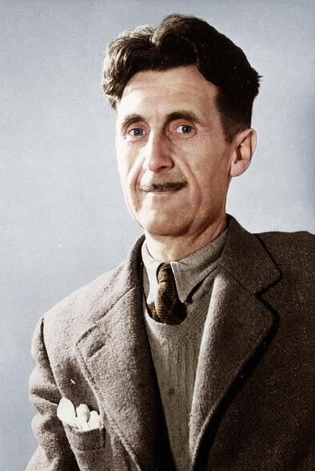
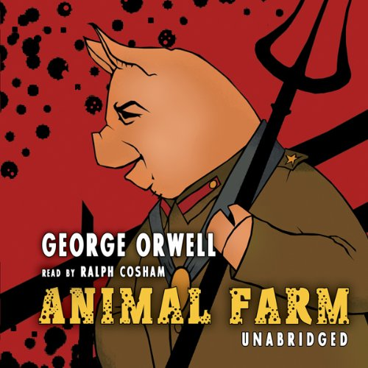
George Orwell
Animal Farm (1945); written in 1943
Satire of Stalin and Communism
“To combat the negative influence of the Soviet myth upon the Western Socialist movement.”
Politically incorrect because USSR is the ally of UK in WWII
Rejected by 4 English publishers before it could be published.

Slide 20
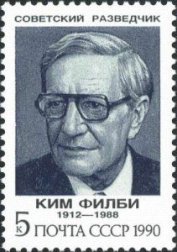
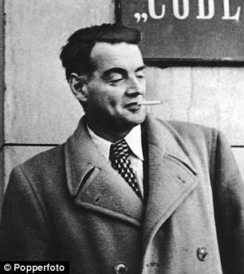
George Orwell
Soviet spy Peter Smollett (recruited by Kim Philby) advised publishers not to publish the book.
Became best-sellers in UK and US.
Translated in 60 languages.
“All animals are equal, but some animals are more equal than others”

Slide 21
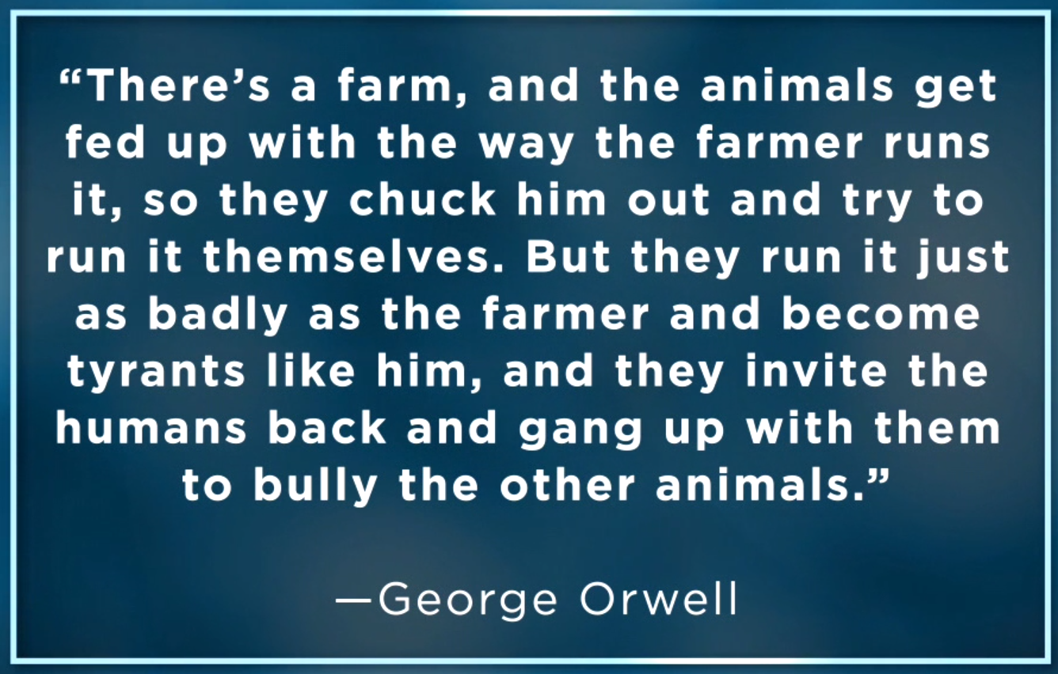
George Orwell

Slide 22
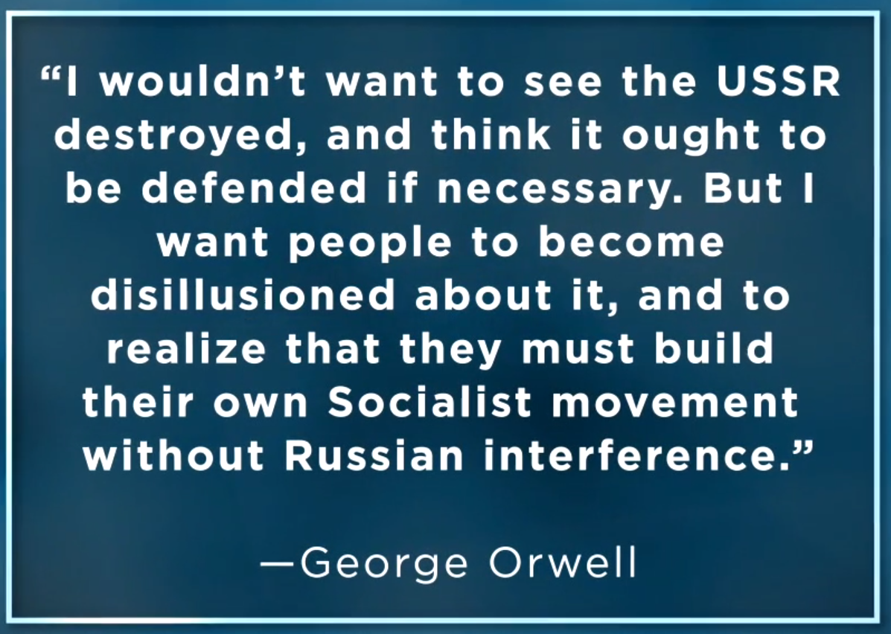
George Orwell

Slide 23
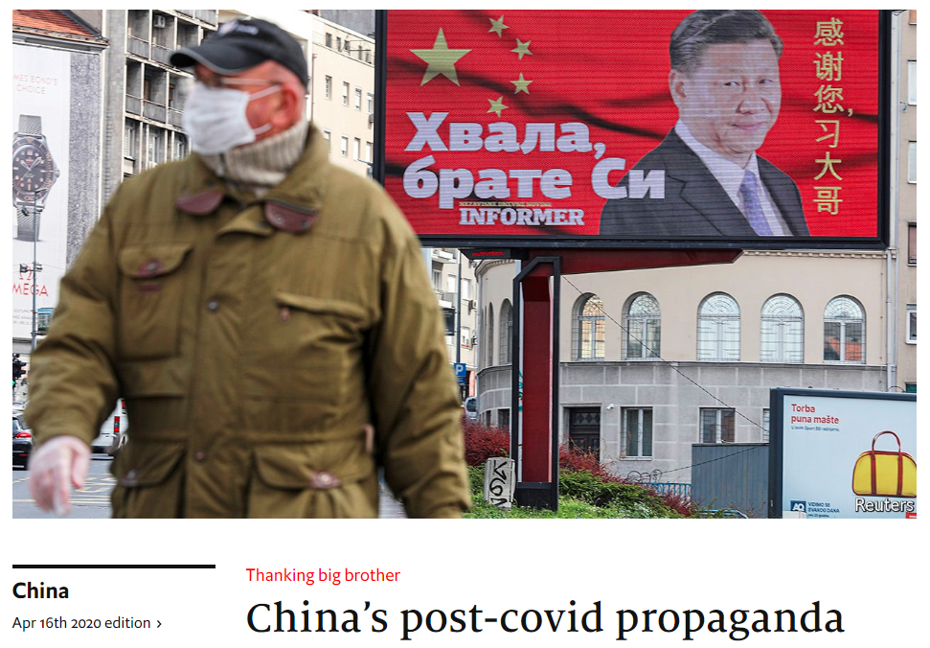

Slide 24
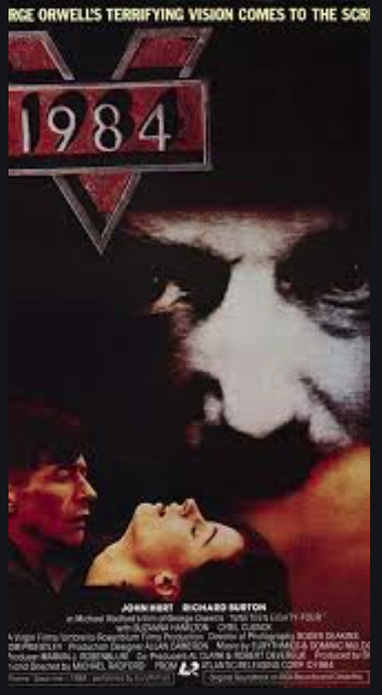
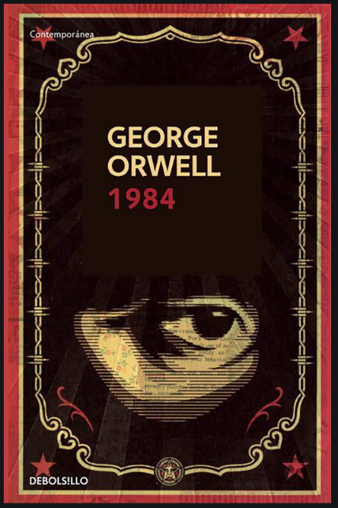
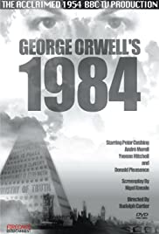
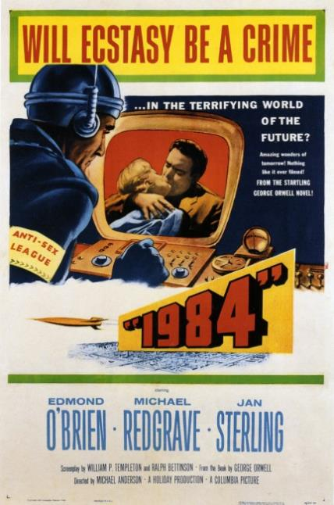
George Orwell: 1984
TV: 1954
Book: 1948
Movie: 1956
Movie: 1984

Slide 25
George Orwell: 1984
The story is situated in 1984.
After the nuclear war of 1965, the world has been ruled by three superpowers, Oceania, Eurasia and Eastasia. Oceania.
People live under the benevolent rule of Big Brother and TV/cameras is installed everywhere monitor their activities.
The mission of the Ministry of Truth is to alter newspaper articles and remove all references to people that are labelled traitors.
Independent thought is suppressed; people are manipulated to hate the enemy of the state and to follow the party line in everything.
https://www.youtube.com/watch?v=XvGmOZ5T6_Y

Slide 26
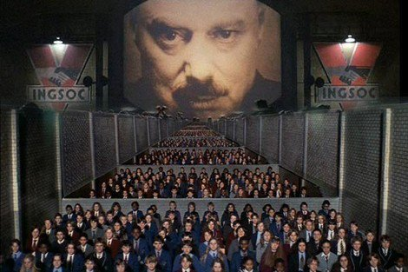
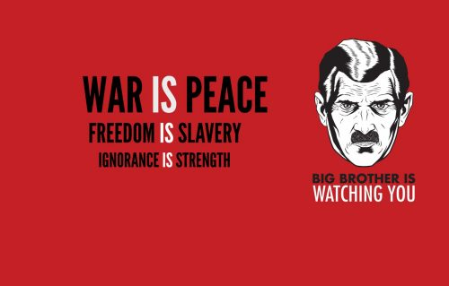
George Orwell: 1984
“The big brother is watching you.”
“War is peace, freedom is slavery, and ignorance is strength.”
People’s democratic dictatorship
Democratic collective system

Slide 27
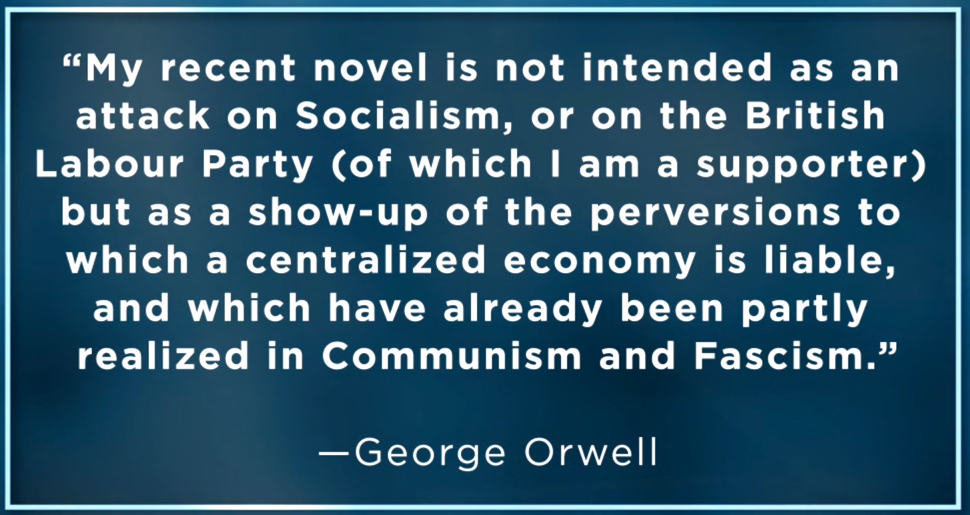
George Orwell: 1984

